Slide 1
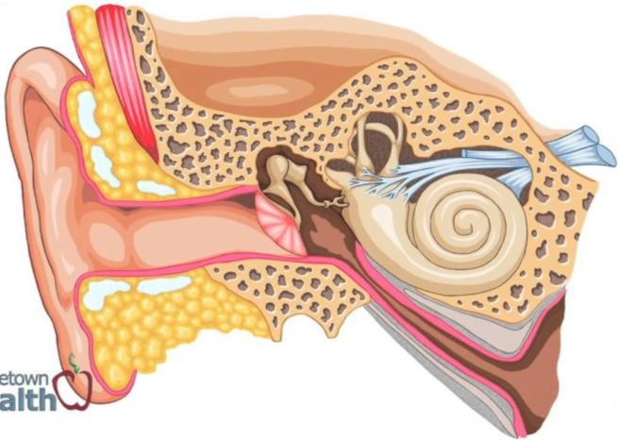
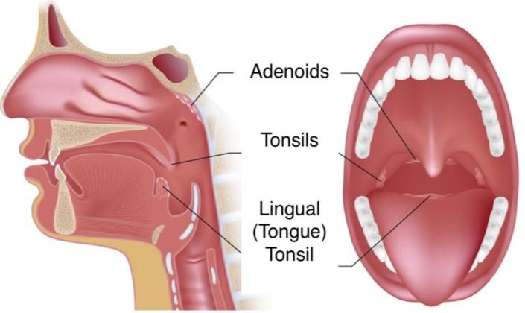
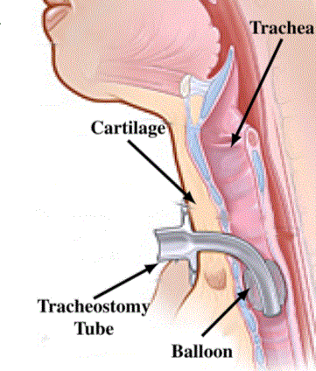
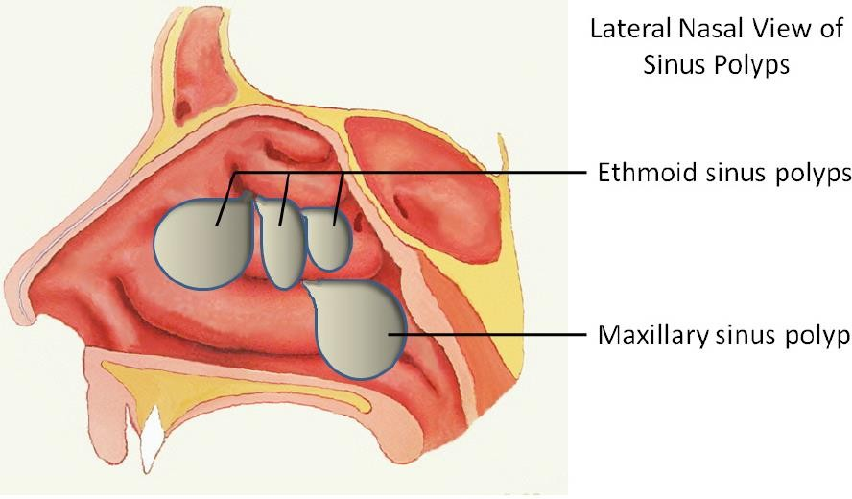
STUDY GUIDE
EAR, NOSE & THROAT
MODULE
FOURTH YEAR MBBS

Slide 2
AVICENNA MEDICAL COLLEGE
4TH YEAR MBBS, SEAR, NOSE & THROAT MODULE
STUDY GUIDE
EAR, NOSE & THROAT MODULE SEMESTER VII, FOURTH YEAR MBBS
S. No | CONTENTS | Page No
1 | List of Integrated Modular Committee Members | 03
2 | Introduction to Integrated Curriculum | 04
3 | Learning Methodologies | 06
4 | Module: Ear, Nose & Throat | 07
5 | Importance | 07
6 | Objectives and Strategies | 08
6.1 | Learning Resources | 14
6.2 | Assessment Methods | 15
7 | Semester Examination Rules and Regulations of UHS | 17
8 | Modular Examination Rules and Regulations (AVMC) | 19
9 | Schedule | 20
10 | Appendices A & B | 21

Slide 3
AVICENNA MEDICAL COLLEGE
4TH YEAR MBBS, EAR, NOSE & THROAT MODULE
MODULE INTEGRATED COMMITTEE
MODULE COORDINATOR: | Prof.Dr.Ayub Khan
CO-COORDINATORS: | Dr.Rizwan Akbar Dr. Zulifqar Saleem.
DEPARTMENTS & RESOURCE PERSONS
BASIC HEALTH SCIENCES | CLINICAL AND ANCILLARY DEPARTMENTS
ANATOMY Professor Rehana Shahid Professor Sonia Bashir | ENT Professor.Ayub Khan Dr.Rizwan Akbar
PHARMACOLOGY Professor Rana tariq mahmood | RESEARCH AND SKILLS DEVELOPMENT CENTER Prof. Rana Akhtar
PHYSIOLOGY Professor Binyamin Ahmed | PLASTIC SURGERY Dr. Zulifqar Saleem.
PATHOLOGY Professor Robenna Hafeez
LNH&MC MANAGEMENT Professorr.Dr. Gulfreen Waheed, Dean & Principal, Director AVMC Dr.Brg. Gul-e-rana Controller AVMC
STUDY GUIDE COMPILED BY: Department of Health Care Education | Dr. Sadia Awan Dr. Muhammad Muzzammil Sadiq Dr. Usama Bin Ishtiaq

Slide 4
AVICENNA MEDICAL COLLEGE
4TH YEAR MBBS, EAR, NOSE & THROAT MODULE
CURRICULUM FRAMEWORK
Students will experience integrated curriculum in 4th year, semester VII at LNMC in accordance with the
JSMU guidelines and most recent developments that have an impact on individual health. In semester VII, two groups of fifty students will be formed. Group I (A & B) of 50 students will experience ENT Module, and 50 students of Group II (C & D) will experience Eye module. In semester VIII, these groups will switch in order to get the whole batch of 4th year MBBS students trained for both Eye and ENT modules.
INTEGRATED CURRICULUM is comprised of system-based modules such as ENT, Eye, Reproductive module II and Orthopedics. This integrates basic science knowledge of anatomy, physiology, pharmacology and pathology to clinical problems and presentations of ENT diseases. Integrated curriculum means that subjects are presented as a meaningful whole for better understanding of basic sciences in relation to clinical experience and application.
COMMUNITY MEDICINE*
BIO-ETHICS*
ANATOMY
PHYSIOLOGY
ENT MODULE
PLASTIC SURGERY
PATHOLOGY
PHARMACOLOGY
*Community Medicine & Bio-ethics will run parallel throughout the semester

Slide 5
AVICENNA MEDICAL COLLEGE
4TH YEAR MBBS, S EAR, NOSE & THROAT MODULE
LEARNING METHODOLGIES
The module focuses on integrating basic health sciences to clinical medicine. Teaching and learning methodologies will be a combination of interactive lectures, tutorials, small group sessions, and task oriented learning, e-learning, skills teaching sessions and clinical postings.
Teaching/Learning Technique | Icons
Interactive Lectures
Clinical rotations
Small Group Sessions/ Task oriented learning
Case- Based Discussions
Self-Directed Study
E-Learning (edmodo, websites, podcasts)

Slide 6
AVICENNA MEDICAL COLLEGE
4TH YEAR MBBS, EAR, NOSE & THROAT MODULE
Task Oriented Learning
In this module, objectives will be achieved by using multiple instructional strategies other than lectures only. Task oriented learning is being introduced to enhance students’ learning and to get insight of the content necessary to move forward in to practical application of course materials. Students will be engaged in self directed learning as well as peers’ collaboration and faculty led instructions
Process of TOL
Learning in this strategy will comprises of two stages Stage 1: Pre-class learning in groups
Stage 2: In-class group focused active learning
Stage 1 (Pre-class)
Stage 2 (In-class)
Individual/group study
and group presentation preparation
Group presentation and assessment by facilitator followed by Q/A session
TOL process stage 1: Students will be divided in 6 groups (8-9 members in each group). Each week, students’ group will be given task based on few objectives. These objectives will be posted on edmodo (For groupings see Appendix B).
Link for edmodo: https://support.edmodo.com/hc/en-us/articles/205009754-Student-Sign-Up Class name for Group A and B: 4thyr jsmu VII A
Class code: w7yjvu
Students will have defined time slots for achieving the objectives. They will be required to study the recommended authentic website (patient education websites are strictly NOT ADVISED!!!) and work in groups to develop presentations during allotted study hours.
TOL process stage 2: The groups will then be required to present their PPT/Prezi in class to show their understanding of subject matter.
Time for group presentation: Each presentation should not exceed 10 minutes followed by five minutes discussion
Assessment
The group presentations and collaborative work will be graded on defined criteria (See Appendix A). Each student is to demonstrate active participation and effective contribution during the group activities. It is mandatory for the students to participate in this activity as their scores will contribute to internal evaluation.

Slide 7
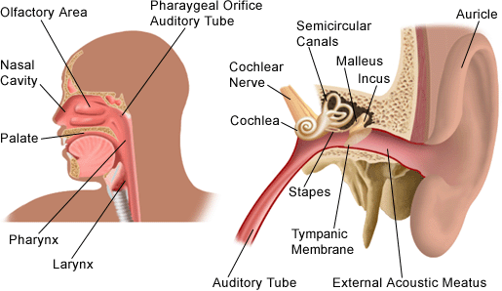
AVICENNA MEDICAL COLLEGE
4TH YEAR MBBS, EAR, NOSE & THROAT MODULE
SEMESTER VII MODULE 1: Ear, Nose & Throat IMPORTANCE
As a general trend, disease burden is increasing with passage of time and is also true for common ENT problems. According to a local study, the highest incidence is noted for ear diseases; especially discharging ear, followed by nose (rhinosinusitis) and throat (sore throat) respectively with a general increasing trend over the past decade (Z. Awan, 2009). So this module is designed to specifically address the basic needs of medical students as graduating doctors, enabling them to diagnose and treat common everyday diseases of ear, nose and throat and contribute to better overall health care.
AIMS OF THIS MODULE
The module aims to provide:
Knowledge and understanding of the structures and functions of the ear, nose and throat with application to clinical practice, integrating basic science knowledge to solve and manage common related diseases in community
Knowledge and understanding of the origin and associated risk factors of common diseases of ear, nose and throat and application in real context
Application of knowledge in management and prevention of common pathologies of ear, nose and throat
Practice of basic skills used to diagnose and treat diseases in a simulated clinical setting
Knowledge of drugs used to treat ear, nose and throat diseases and their application

Slide 8
AVICENNA MEDICAL COLLEGE
4TH YEAR MBBS, EAR, NOSE & THROAT MODULE
COURSE OBJECTIVES & TEACHING LEARNING STRATEGIES:
At the end of the module, the student will be able to
NOSE
OBJECTIVES | SUBJECTS/ TOPICS | TEACHING & LEARNING STRATEGIES
Correlate the anatomy of nose and paranasal sinuses with their clinical presentations | Anatomy | Interactive lectures/ Small group sessions
Correlate the process of olfaction with diseases of nasal cavity | Physiology
Explain the pathology of the diseases of nasal cavity | Pathology
Describe pharmacological treatment of common nasal pathologies Advise prescriptions for rhinosinusitis | Pharmacology
Diagnose fractures of the external nose based on history, clinical examination and investigation Develop management plan for trauma to external nose | ENT External nose | Interactive lectures
Diagnose epistaxis, deviated nasal septum, hematoma, septal abscess and perforation Discuss management plans for epistaxis, deviated nasal septum, hematoma, septal abscess and perforation | Septum
Define polyps Diagnose ethmoidal and antrochoanal polyps Discuss management plans for ethmoidal and antrochoanal polyps | Polyps
Diagnose foreign bodies in nose (i.e. rhinoliths) based on clinical examination & investigation Discuss management plans for rhinolith | Foreign body
Discuss the etiology, pathophysiology, clinical presentations, examination findings, investigations, differential diagnosis for acute and chronic sinusitis Discuss complications of sinusitis Develop treatment plan for sinusitis | Sinusitis | Task oriented learning/ Small group sessions
Describe the etiology, pathophysiology, clinical presentations, investigations and treatment plans for allergic rhinitis and rhinitis due to foreign bodies | Rhinitis
Diagnose fungal sinusitis based on the basis of clinical presentation and investigations | Sinusitis | Task oriented learning

Slide 9
AVICENNA MEDICAL COLLEGE
4TH YEAR MBBS, SEAR, NOSE & THROAT MODULE
 | Discuss management plans for fungal sinusitis
 | Order investigations, develop differential diagnosis and treatment plans for headaches with emphasis on ENT causes | ENT causes of headache | Interactive lectures
 | Diagnose congenital lesions of external nose (choanal atresia) based on clinical examination and investigation Discuss management plans for external nose deformities | External nose | Interactive lectures
 | Describe the etiology, pathophysiology, clinical presentations, investigations and treatment plans for common types of atrophic rhinitis, hypertrophic rhinitis and VMR Diagnose CSF rhinorrhoea based on clinical examination and investigations | Rhinosinusitis | Task oriented learning/ Small group sessions
 | Diagnose bleeding polyps Discuss management plans for bleeding polyps | Polyps | Interactive lectures
 | Diagnose foreign bodies in nose (i.e. maggots) based on examination & investigations Discuss management plans for maggots | Foreign body
EAR
OBJECTIVES | SUBJECTS/ TOPICS | TEACHING & LEARNING STRATEGIES
Correlate the anatomy of ear with clinical presentations of ear diseases | Anatomy | Interactive lectures/ Small group sessions
Correlate the process of hearing with clinical presentations of ear diseases | Physiology
Correlate the pathogenesis of ear diseases with clinical presentations of ear diseases | Pathology
Describe pharmacological treatment of common pathologies of ear Advise prescriptions for: Otomycosis Acute otitis media Otitis externa | Pharmacology
Discuss the etiology, investigations, treatment and complications for acute otitis externa Develop management plan for impacted wax and foreign body | ENT External ear | Interactive lectures

Slide 10
AVICENNA MEDICAL COLLEGE
4TH YEAR MBBS, EAR, NOSE & THROAT MODULE
 | Discuss the etiology, pathophysiology, clinical presentations, examination findings, investigations and treatment plans for: Acute otitis media Serous otitis media Chronic otitis media Diagnosis and develop management plans for complications of otitis media and mastoiditis | Middle ear | Interactive lectures/ Case-based discussions
 | Define deafness List causes of deafness Interpret investigation findings related to deafness Diagnose deafness and mutism in a child Discuss the clinical presentations and treatment options for: Vestibular neuritis Benign paroxysmal positional vertigo Meniere’s Disease Migraine-associated vertigo Discuss the differential diagnosis, investigations and treatment of: Tinnitus Acoustic Neuroma | Inner ear | Interactive lectures/ Small group sessions/ Case-based discussions
 | Describe management plan for pinna trauma and traumatic rupture of tympanic membrane Discuss the etiology, investigations, treatment and complications for malignant otitis externa Discuss the clinical presentations, examination findings, investigations and treatment plans for benign tumors of external ear | External ear | Interactive lectures
 | Discuss the etiology, investigations, treatment and complications for: Myringitis bullosa, Perichondritis and Fungal infections Discuss the clinical presentations, examination findings, investigations and treatment plans for malignant tumors of external ear | External ear
 | Discuss the etiology, pathophysiology, clinical presentations, examination findings, investigations and treatment plans for acute necrotising otitis media Discuss the clinical presentations, examination findings, investigations and treatment plans for benign and malignant tumors of middle ear | Middle ear | Interactive lectures/ Case-based discussions

Slide 11
AVICENNA MEDICAL COLLEGE
4TH YEAR MBBS, EAR, NOSE & THROAT MODULE
HEAD & NECK, OROPHARYNX, LARYNX, OESOPHAGUS
OBJECTVES | SUBJECTS/ TOPICS | TEACHING & LEARNING STRATEGIES
Correlate the process of salivation, phonation and speech with common diseases of oropharynx | Physiology | Interactive lectures/ Small group sessions
Correlate the pathogenersis of the diseases involving oral cavity, neck and salivary glands with clinical presentations of associated diseases | Pathology
Correlate the anatomy of the oral cavity, salivary glands, larynx, pharynx, neck and oesophagus (oral, pharyngeal and oesophageal parts) with clinical presentations of associated diseases | Anatomy
Describe pharmacological treatment of common oropharyngeal pathologies Advise prescriptions for: Acute tonsillitis Peritonsillar abscess Pharyngitis | Pharmacology
Discuss the risk factors, etiology and pathophysiology of: Basal Cell Squamous CellCarcinoma Papilloma Osteoma | Pathology
Diagnose cleft palate, hare lip based on clinical presentation and investigations Correlate the embryological defects and etiology of cleft lip and palate with their clinical presentation Describe treatment options for cleft lip and palate | Plastic Surgery | Interactive lectures
Discuss the differential diagnosis for neck mass based on symptoms, signs and investigations Diagnose salivary gland conditions (neoplastic, non- neoplastic and parotitis) based on clinical presentations and investigations | ENT Head & Neck
Justify diagnosis of oral cavity ulcers based on history, clinical presentations and investigations Develop treatment plans for oral cavity ulcers (Aphthus, Thrush & Leukoplakia) Justify diagnosis of the following based on history, clinical presentations and investigations: Tonsillitis | Oropharynx | Interactive lectures/ Small group sessions

Slide 12
AVICENNA MEDICAL COLLEGE
4TH YEAR MBBS, EAR, NOSE & THROAT MODULE
 | Peritonsillitis Peritonsillar abscess Develop treatment plans for: Tonsillitis Peritonsillitis Peritonsillar abscess
 | Describe etiology, pathophysiology, investigations and principles of treatment for: Vocal Nodules Vocal cord paralysis Diagnose layryngitis based on symptoms, signs and investigations Develop treatment and follow up plans for: Vocal cord nodules Vocal cord paralysis Laryngitis Describe the etiology and pathophysiology of supraglottitis Classify laryngeal tumors Diagnose the following based on symptoms, signs and investigations: Papilloma Laryrnx Laryngeal Polyps Laryngeal Carcinoma | Larynx | Task oriented learning/ Small group sessions
 | Develop differential diagnosis of: Thyroglossal cyst/ sinus Pre-auricular cyst/ sinus Branchial Cyst Branchial Fistula | Head & Neck | Task oriented learning/ Small group sessions
 | Justify diagnosis of oral malignant ulcers on the basis of clinical presentation and investigations Develop treatment plans for oral malignant ulcers Justify diagnosis of the following on the basis of clinical presentation and investigations and develop treatment plan: Tumors of tonsils Sleep aponea syndrome Ludwig’s angina | Oropharynx | Task oriented learning/ Small group sessions
 | Describe the etiology and pathophysiology of Diphtheria Diagnose Diphtheria based on symptoms, signs and investigations Develop treatment and follow plans for Diphtheria | Larynx | Task oriented learning/ Small group sessions
 | Describe etiology, pathophysiology, differential diagnosis and investigations for dysphagia (oral, | Oesophagus | Interactive lectures

Slide 13
AVICENNA MEDICAL COLLEGE
4TH YEAR MBBS, EAR, NOSE & THROAT MODULE
 | pharyngeal and esophageal) Describe indications, contraindications and complication of Oesophagoscopy
 | Discuss investigations, differential diagnosis and treatment plans for: Traumatic Vincents Angina Agranulocytic Tuberculous Behcet’s Disease Ulcerative lesions of Oral Cavity Discuss investigations, differential diagnosis and treatment plans for pharyngeal & retro-pharyngeal abscesses | Oropharynx | Interactive lectures/ Small group sessions
 | Describe etiology, pathophysiology, investigations and principles of treatment for: Glottic stenosis/ Larynogocoele, Laryngomalacia Describe etiology and pathophysiology, diagnosis, investigations and management plans for: Syphilis Leprosy Non-specific laryngitis | Larynx | Task oriented learning/ Small group sessions
 | Classify Oesophageal carcinoma Diagnose Oesophageal carcinoma based on symptoms, signs and investigations Develop treatment and follow-up plans for Oesophageal carcinoma | Oesophagus | Interactive lectures
 | Demonstrate tracheostomy technique on the simulator (indications, contraindications, technique and post-procedure care) Demonstrate suctioning of the tracheostomy tube on the simulator | RSDC | Small group sessions

Slide 14
AVICENNA MEDICAL COLLEGE
4TH YEAR MBBS, EAR, NOSE & THROAT MODULE
LEARNING RESOURCES
SUBJECT | LEARNING RESOURCES
ANATOMY | K.L. Moore, Clinically Oriented Anatomy Neuro Anatomy by Richard Snell
COMMUNITYMEDICINE | Community Medicine by Parikh Community Medicine by Muhammad Iliyas Basic Statistics for the Health Sciences by Jan W Kuzma
PATHOLOGY | Robbins & Cotran, Pathologic Basis of Disease, 9th edition. Rapid Review Pathology, 4th edition by Edward F. Goljan MD
PHARMACOLOGY | Lippincot Illustrated Pharmacology Basic and Clinical Pharmacology by Katzung
PHYSIOLOGY | 1. Textbook of Medical Physiology by Guyton And Hall
ENT | Diseases of Ear, nose and Throat by Logan Turner, 11th edition Lecture notes Ear, Nose and Throat Notes by P. D. Bull, 10th edition Diseases of Ear, Nose and Throat by P.L. Dhingra, 6th edition (optional reading) Reference Books Current medical diagnosis & treatment by Maxine A. Papadakis Scott-Brown’s Otorhinolaryngology, Head & Neck Surgery Links for references http://sfo.entuk.org/services/undergraduate-curriculum https://www.omicsonline.org/open-access/teaching-ent-in- primary-care-2161-119X-1000228.php https://www.researchgate.net/publication/287718949_Statistical_ analysis_of_Ear_Nose_and_Throat_ENT_diseases_in_paediatric_p opulation_at_PIMS_Islamabad_10_Years_experience
ADDITIONAL LEARNING RESOURCES
Museum | Models available in the museum are a rich learning resource for quick review of anatomy and related educational activities
Skill Lab | Skills acquisition in a simulated environment in the skills lab involving experiential learning will ensure patient safety and will also help to build confidence in approaching the patients
Videos/Podcasts | Videos and podcasts(uploaded on edmodo) will familiarize the student with the procedures and protocol which they can watch and listen to at any time and wherever they are, as part of task oriented learning
Internet Resources | Students will use easily accessible internet resources (e.g. edmodo ) with added time flexibility to enrich and update their knowledge and its application

Slide 15
AVICENNA MEDICAL COLLEGGE
4TH YEAR MBBS, EAR, NOSE & THROAT MODULE
ASSESSMENT METHODS:
Theory:
Best Choice Questions (BCQs) also known as MCQs (Multiple Choice Questions) are used to asses objectives covered in each module.
A BCQ has a statement or clinical scenario followed by four options (likely answer).
Students after r e a d i n g t h e statement/scenario s e l e c t O N E , t h e m o s t appropriate response from the given list of options.
Correct answer carries one mark, and incorrect ‘zero mark’. There is no negative marking.
Students mark their responses on specified computer-based/OMR sheet designed for AVMC
EMQs:
An EMQ has:
An option list of 5-15 which may be nerve supply, functions, diagnosis, investigations etc
A Lead In –Statement/Question
Two to four Stems or Clinical Scenarios
For each stem or clinical scenario, the student should choose the most appropriate option from the option list.
A single option can be used once, more than once or not at all.
Correct answer carries one mark and incorrect ‘zero mark’. There is NO negative marking.
Student mark their responses on a specified computer-based sheet for EMQs.
OSPE/OSCE: Objective Structured Practical/Clinical Examination:
Each student will be assessed on the same content and have same time to complete the task.
Comprise of 12-25 stations.
Each station may assess a variety of clinical tasks, these tasks may include history taking, physical examination, skills and application of skills and knowledge
Stations are observed, unobserved, interactive and rest stations.
Observed and Interactive Stations:
They will be assessed by internal or external examiners through structured viva or tasks.
Unobserved Stations:
It will be static stations in which there may be an X-ray, Labs reports, pictures, clinical scenarios with related questions for students to answer on the provided answer copy.
Rest station
I t is a station where there is no task given and in this time student can organize

Slide 16
AVICENNA MEDICAL COLLEGE
4TH YEAR MBBS, EAR, NOSE & THROAT MODULE
his/her thoughts.
AVMC Internal Evaluation Policy
Students will be assessed to determine achievement of module objectives through the following:
Module Examination: will be scheduled on completion of each module. The method of examination comprises theory exam which includes BCQs and OSPE (Objective Structured Practical Examination).
Graded Assessment of students by Individual Department: Quiz, viva, practical, assignment, small group activities such as CBL, TBL, TOL, online assessment, ward activities, examination, and log book.
Marks of both modular examination and graded assessment will constitute 20% weightage.
As per UHS policy, this 20% will be added by UHS to Semester Examination.
Example : Number of JSMU Marks allocated for Semester Theory and Internal Evaluation
Semester | Semester Examination Theory Marks | Internal Evaluation (Task Presentation + Assignments + Modular Exam | Total (Theory)
 | 80% | 20% | 100%
Formative Assessment
Individual department may hold quiz or short answer questions to help students assess their own learning. The marks obtained are not included in the internal evaluation
More than 75% attendance is needed to sit for the modular and semester examinations

Slide 17
AVICENNA MEDICAL COLLEGE
4TH YEAR MBBS, EAR, NOSE & THROAT MODULE
MODULAR EXAMINATION RULES & REGULATIONS (AVMC)
Student must report to examination hall/venue, 30 minutes before the exam.
Exam will begin sharp at the given time.
No student will be allowed to enter the examination hall after 15 minutes of scheduled examination time.
Students must sit according to their roll numbers mentioned on the seats.
Cell phones are strictly not allowed in examination hall.
If any student is found with cell phone in any mode (silent, switched off or on) he/she will be not be allowed to continue their exam.
No students will be allowed to sit in exam without University Admit Card, AVMC College ID Card and Lab Coat
Student must bring the following stationary items for the exam: Pen, Pencil, Eraser, and Sharpener.
Indiscipline in the exam hall/venue is not acceptable. Students must not possess any written material or communicate with their fellow students.

Slide 18
AVICENNA MEDICAL COLLEGE
4TH YEAR MBBS, EAR, NOSE & THROAT MODULE
Examination Protocols:
In each semester, module will be assessed by theory paper comprising MCQs and EMQs. For example semester 8 will have separate theory paper of EYE, Dermatology, Plastic Surgery & Burns, Neuro-Sciences-II & Psychiatry, Genetics and Rehabilitation modules.
There will be one OSPE (Objective Structured Practical Examination)/OSCE (Objective Structured Clinical Examinations) which will cover all three modules of semester seven.
Theory
Theory paper will comprise of 80 one best type MCQs and 20 EMQs.
Time duration for theory paper will be 120 minutes.
Students will mark their responses on UHS specified response sheets assessed by computer software.
It will carry out 80% contribution in theory results of the Semester.
There is no negative marking.
OSPE/OSCE:
It may comprise between 12- 25 stations. Each station will carry 10 marks.
UHS Grading System
It will be based on GPA – 4 system
Marks obtained in Percentage range | Numerical Grade | Alphabetical Grade
80-100 | 4.0 | A+
75-79 | 4.0 | A
70-74 | 3.7 | A-
67-69 | 3.3 | B+
63-66 | 3.0 | B
60-62 | 2.7 | B-
56-59 | 2.3 | C+
50-55 | 2.0 | C
<50 Un-grade-able | 0 | U
A candidate obtaining GPA less than 2.00 (50%) is declared un-graded (fail).
Cumulative transcript is issued at the end of clearance of all modules.

Slide 19
AVICENNA MEDICAL COLLEGE
4TH YEAR MBBS, EAR, NOSE & THROAT MODULE
Retake Examination
Retake examinations are for those students who fail in semester examinations and those who have passed semester examinations with GPA less than 3.0 may reappear in respective retake examination to improve grades.
The format of the retake examination is exactly the same as in semester examinations.
Retake examination will be conducted 3 weeks after declaration of results.
Promotion to next class
Students who pass both semester examinations are promoted from first year to second year.
Students who fail the MBBS first year semester retake examination will be promoted to second year.
Students will be promoted from second year to third year and onward only if they have passed the semester examinations of that year.
Clearance of all modules and their components of semester one to four are mandatory for promotion from second year to third year (as per PMDC rules).
As per PMDC rules any candidate failing to clear a module or its component in four (1+3) attempts is NOT allowed to carry out further medical education.
Clearance of all modules and their components of semester/s are mandatory for promotion from third year onward.

