Slide 1
Wound Types And Management
Prepared by:
Imran iqbal
Clinical instructor

Slide 2
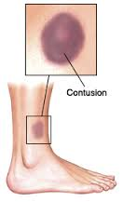
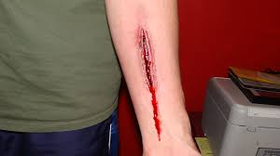
DEFINITION
A wound is a type of injury, which happens relatively, quickly in which skin is torn, cut, or puncture or where blunt force trauma causes a contusion.

Slide 3
CLASSIFICATION
MAINLY TWO TYPES OF WOUND :
1. OPEN
2. CLOSED
According to level of contamination a wound can be classified :
1. Clean wound
2. Contaminated wound
3. Infected wound & Colonized wound

Slide 4
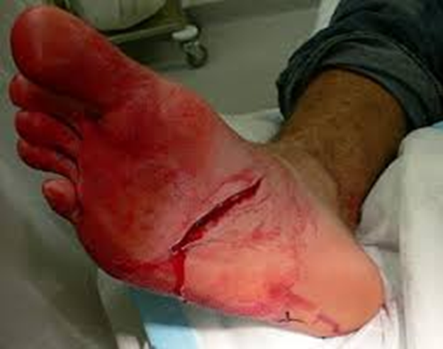
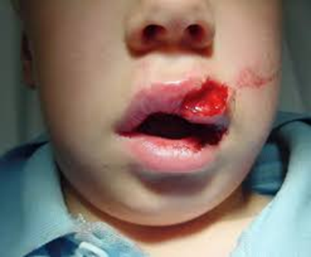
OPEN WOUNDS
Open wounds can be classified according to the object that caused the wound.
Incisions or incised wounds: caused by a clean sharp-edged object such as a knife, razor or glass splinter.
Lacerations: irregular tear-like wounds caused by some blunt trauma.

Slide 5
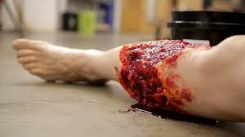
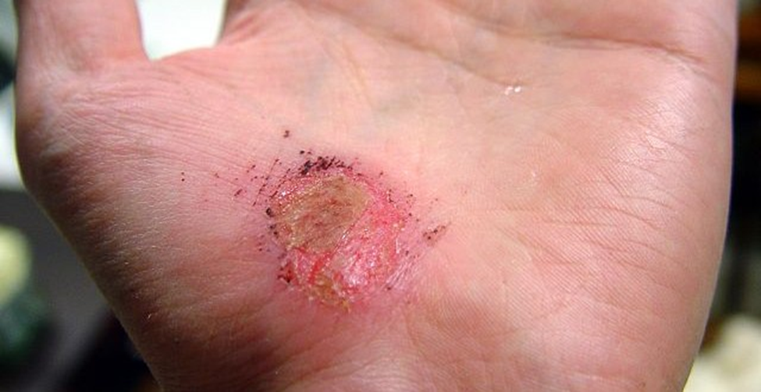
OPEN WOUNDS
Avulsions: injuries in which a body structure is forcibly
detached from its normal point of insertion
Abrasions: (grazes), superficial wounds in which the topmost layer of the skin (the epidermis) scraped off. Abrasions are often caused by a sliding fall onto a rough surface.

Slide 6
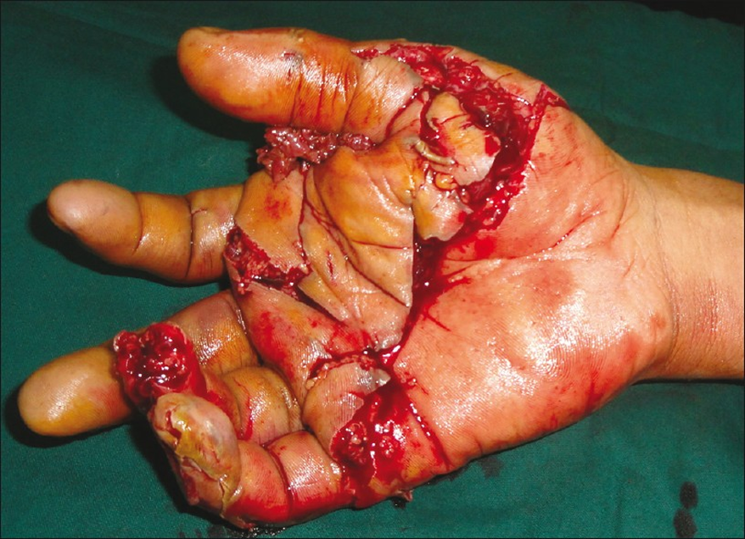
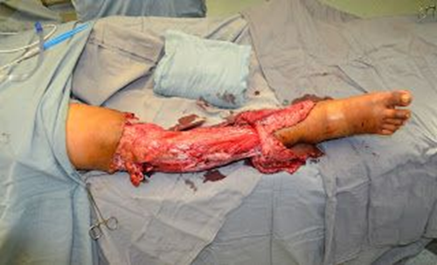
OPEN WOUNDS
A crush injury: is injury by an object that causes compression of the body. This form of injury is common following a natural disaster or after some form of trauma from a deliberate attack. Common concerns after an injury of this type are rhabdomyolysis and crush syndrome.

Slide 7
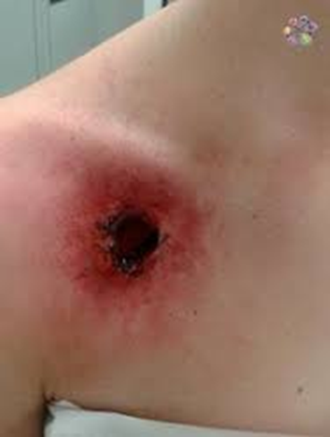
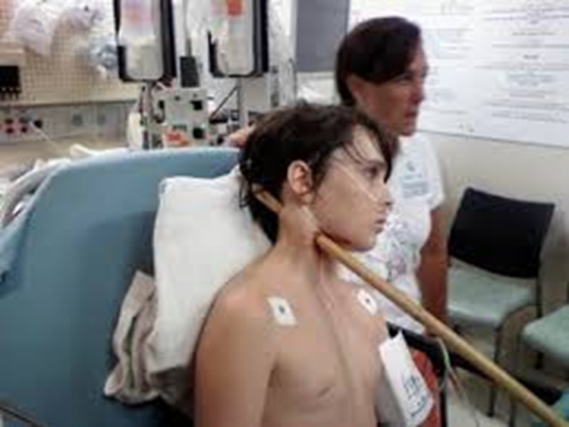
OPEN WOUNDS
Gunshot wounds: caused by a bullet or similar projectile driving into or through the body.
Puncture wounds: caused by an object puncturing the skin, such as a splinter, nail or needle.
Penetration wounds: caused by an object entering and coming out from the skin.

Slide 8
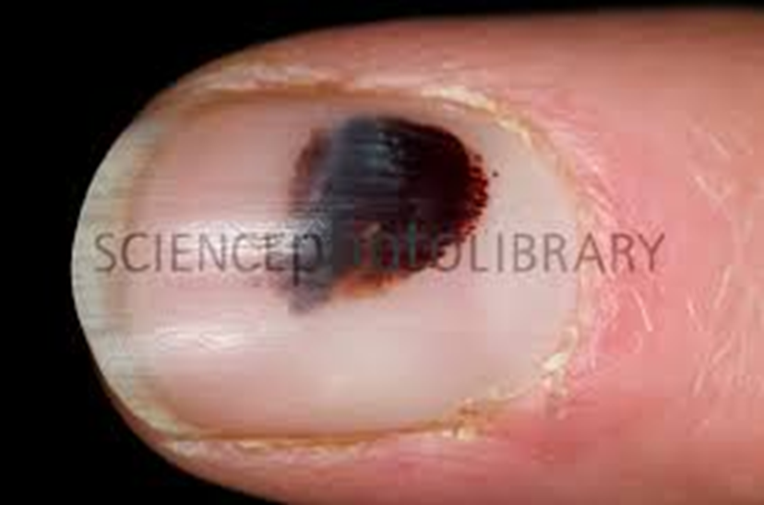
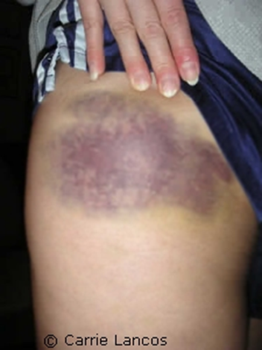
CLOSED WOUNDS
The types of closed wounds are:
Hematomas: also called a blood tumor, caused by damage
to a blood vessel that in turn causes blood to collect under the skin.

Slide 9
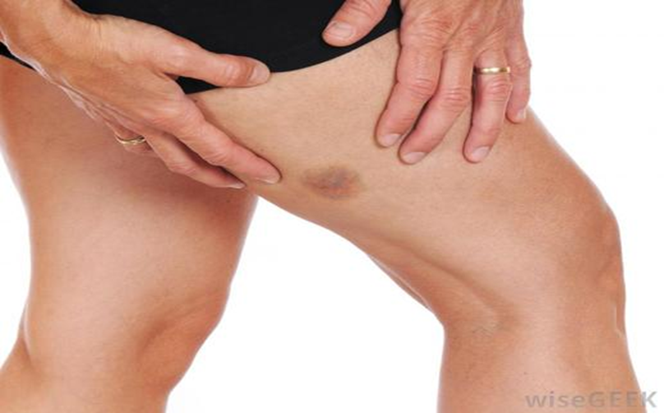
CLOSED WOUNDS
Contusions: These are a common type of sports injury, where a direct blunt trauma can damage the small blood vessels and capillaries, muscles and underlying tissue, as well the internal organs and, in some cases, bone. Contusions present as a painful bruise with reddish to bluish discoloration that spreads over the injured area of skin

Slide 10
GENERAL MANAGEMENT
Apply direct pressure to any bleeding wound, to control hemorrhage.
Examine wounds for gross contamination, devitalized tissue, and foreign bodies.
Remove constricting rings or other jewelry from injured body part.
Cleanse the wound periphery with soap and sterile water or available solutions, and provide anesthetics and analgesia whenever possible.
Irrigate wounds with saline solution using a large bore needle and syringe.
Leave contaminated wounds, bites, and punctures open.
Remove devitalized tissue and foreign bodies prior to repair as they may increase the incidence of infection.
Cover wounds with dry dressing; deeper wounds may require packing with saline soaked gauze and subsequent coverage with a dry bulky dressing.
Follow tetanus prophylaxis guidelines for all wounded patients.

Slide 11
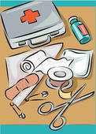
WOUND DRESSING PROCEDURE
Prepared by:
Imran iqbal
Clinical instructor

Slide 12
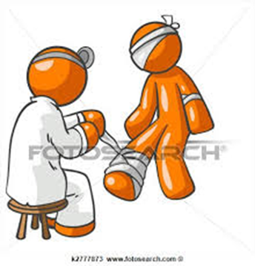
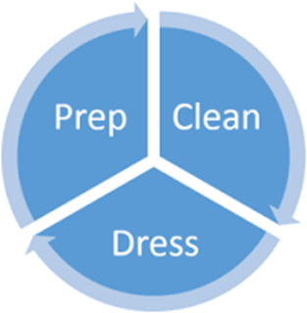
WOUND DRESSING
Important Points:
Review the Physician’s order.
Identify patient using 2 identifiers
3. Explain the procedure to the patient
4. Provide privacy and adequate lighting

Slide 13
WOUND DRESSING
Important Points:
5. Wash hands or use hand rub
6. Clean dressing trolley with disinfectant wipes
7. Collect dressing materials on dressing trolley.
8. Place an absorbent pad under the wound.
9. Place a disposable bag nearby to collect soiled dressings.

Slide 14
WOUND DRESSING
Important Points:
10. Open dressing pack on to the trolley, add
cleansing solution.
11. Disinfect hands & Put on clean gloves.
12. Carefully remove old dressings and discard items
into a disposable bag.
13. Inspect the old dressing for the presence of
infection & inform the Physician.

Slide 15
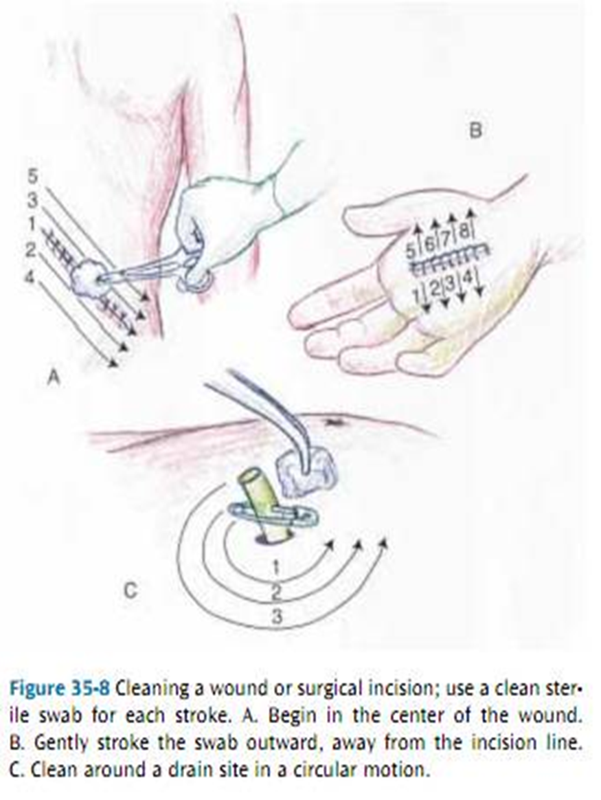
CLEANSING OF WOUND
For open wounds :
Gentle innermost to outermost
circular cleansing pattern.
For closed or sutured wounds:
Clean along the wound edges taking care
to clean each side of the wound separately.
For surgical drain cleansing :
Using small circular motion, cleanse the skin
around the drain using gauze moistened with
cleaning solution, starting from the drain and
working outwards.

Slide 16
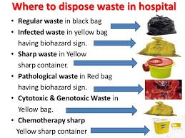
POST DRESSING PROCEDURE
Discard the disposable items according to the hospital protocol and clean the trolley prior to replacing it.
Wash hands or use hand rubs
Documentation

