Slide 1

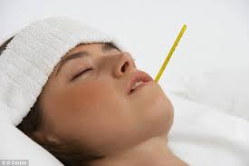
Prepared by:
Imran Iqbal
Clinical Instructor
TEPID SPONGING

Slide 2

OBJECTIVES
By the end of this section you should know to:
• Prepare the patient for the procedure;
• Collect and prepare the equipment;
• Carry out tepid sponging.

Slide 3
INDICATIONS
Tepid sponging is the application of water to the patient’s skin surface to promote dispersal of body heat
when the body temperature is 39.5°C and over. The procedure is based on the principles of evaporation
and conduction.
A patient may be pyrexial when there is:
• Invasion by pathogenic micro organisms;
• Disease of the nervous system;
• Metabolic disorder;
• Malignant/neo-plastic disease.

Slide 4
EQUIPMENTS
• Basin of tepid water (29°C – 32°C)
• Bed linen
• Hospital towels
• Disposable face cloth
• Gown
• Trolley
• Bed linen trolley
• Receptacle for soiled disposables

Slide 5
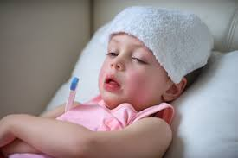
PROCEDURE
• Perform hand hygiene;
• Collect and prepare the equipment;
• Ensure patient understands and consents to procedure;
• Ensure the patient’s privacy;
• Measure, record and document patient’s temperature;
• Sponge the patient’s body using tepid water;

Slide 6
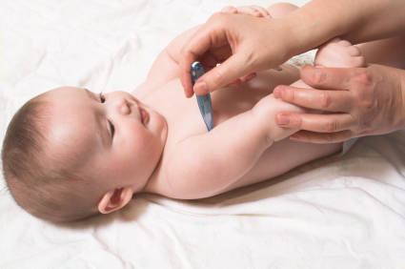
PROCEDURE
• Do not dry patient – leave water to evaporate;
• Perform hand hygiene;
• Change bed linen and patient’s gown;
• Administer 1 g of paracetamol, following Administration of
Medicines procedure;
• Measure and record patient’s temperature twenty minutes
after the tepid sponge;
• Document the procedure, monitor for after-effects and report
abnormal findings immediately.

Slide 7
REFERENCES
1.6 Febrile Response Management cont.
REFERENCES:
1. Barth, I. H. and Musgrave, C. F. (1994) How to treat the febrile cancer patient. Contemporary
Oncology 4(4): 59-60.
2. Connell, F. (1997) The causes and treatment of fever: a literature review. Nursing Standard 12(11):
40-43.
3. Edwards, I. L. (1998) Update: High temperature. Professional Nurse 13(8): 521-523, 525.
4. Grossman, D., Keen, M. F., Singer, M., and Asher, M. (1995) Current nursing practices in fever
management. MEDSURG Nursing 4(3): 193-198.
5. Henker, R., Rogers, S., Kramer, D. J., Kelso, L., Kerr, M., and Sereika, S. (2001) Comparison of
fever treatments in the critically ill: a pilot study. American Journal of Critical Care 10(4): 276-280.
6. Holtzclaw, B. J. (1992) The febrile response in critical care: state of the science. Heart & Lung:
Journal of Critical Care 21(5): 482-501.
7. Miller, C. (1993) Fever: mechanisms, controversy and research based interventions. CACCN 4(4):
30-33.
8. Sund-Levander, M., Wahren, L., and Hamrin, E. (1998) Nursing care in fever: assessment and
implementation. Vard i Norden Nursing Science & Research in the Nordic Countries, 18(2): 22

