Slide 1

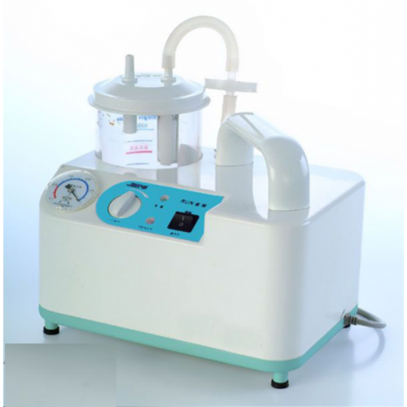
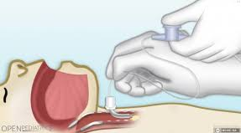

SUCTIONING OF THE AIRWAY
SUCTION
Prepared by: Imran Iqbal
Clinical Instructor

Slide 2

WHAT IS SUCTIONING
SUCTION
Suctioning Definition
Aspirating secretion through a catheter connected to a suction machine or a wall suction outlet.

Slide 3

PATIENT’S SUCTIONING
SUCTION
WHY SUCTIONING IS
SO IMPORTANT ?

Slide 4
PURPOSES
SUCTION
Oral / Nasal suction
Tracheal/ Endotracheal suction
1- To maintain oral/ nasal hygiene.
2- comfort for the patient.
3- remove blood and vomit in an emergency situation.
P
U
R
P
O
S
E
S
Remove pulmonary secretions in patients who are unable to cough and clear their own secretions effectively.

Slide 5
INDICATIONS
SUCTION
Oropharyngeal and Nasopharyngeal suctioning required for:
1- Patient who has undergone head and neck surgery.
2- Signs of respiratory distress .
3- Evidence of unable to cough up and expectorate secretions.
4- Obtain sample of secretion for diagnostic purposes
5- Prevent infection.

Slide 6
DIFFERENCE
SUCTION
Deferent between Oropharyngeal /Nasopharyngeal suctioning and Endotracheal/ tracheostomy suctioning
Endotracheal / Tracheostomy suctioning | Oropharyngeal /Nasopharyngeal suctioning
Remove secretion from the trachea and bronchi or the lower respiratory tract . | Remove secretion from the upper respiratory tract .

Slide 7
INDICATIONS
SUCTION
Tracheal suctioning required for :
1- Patients unable to clear their secretions themselves.
2- patients with mechanical ventilation.

Slide 8

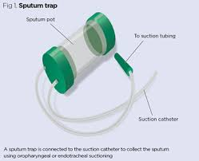
INDICATIONS
SUCTION
1-Therapeutic 2-Diagnostic

Slide 9
Therapeutic
SUCTION
Coarse breath sounds
Noisy breathing
Visible secretions in the airway
Decreased SpO2 in the pulse oximeter
Deterioration of arterial blood gas values
Clinically increased work of breathing
Suspected aspiration of gastric or upper airway secretions
Patients inability to generate an effective spontaneous cough
Changes in monitored flow/pressure graphics
Increased PIP decreased Vt during ventilation

Slide 10
THERAPEUTIC
SUCTION
X-ray changes consistent with retained secretions
The need to maintain the patency and integrity of the artificial airway
The need to stimulate a cough in patients unable to cough effectively secondary to changes in mental status or the influence of medication
Presence of pulmonary atelectasis or consolidation, presumed to be associated with secretion retention
During special procedures like Bronchoscopy
Endoscopy

Slide 11
DIAGNOSTIC
SUCTION
The need to obtain a sputum specimen / ETA
(Endo Tracheal Aspiration) for Bacteriological or
microbiological or cytological investigations.

Slide 12
Nasopharyngeal
Oropharyngeal
Sites for Suctioning
Endotracheal.
Tracheostomy

Slide 13
CHOOSING THE RIGHT SIZE
SUCTION
Size | Age group
#12 to #18 | Adult
#8 to # 10 | Children
# 5 to #8 | Infant
Half the diameter (or less) of the tracheal tube.

Slide 14
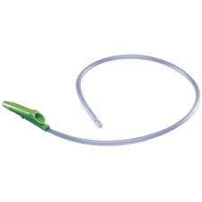
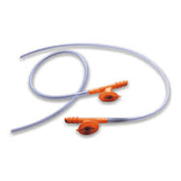
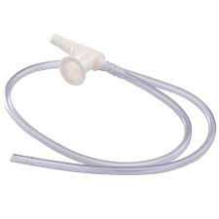
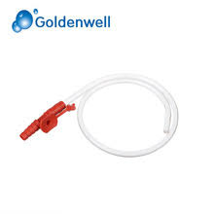
CHOOSING THE RIGHT SIZE
SUCTION
#12 to #18 | Adult Sizes
#14 Fr
#16 Fr
#12 Fr
#12 Fr

Slide 15
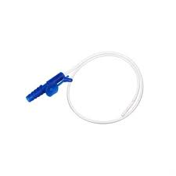
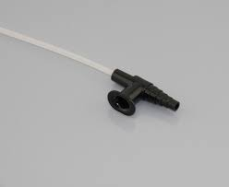
CHOOSING THE RIGHT SIZE
SUCTION
#08 to #10 | Children Sizes
#08 Fr
#10 Fr

Slide 16
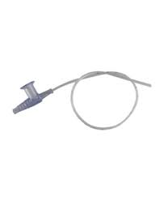
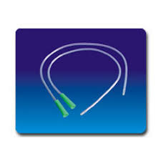
CHOOSING THE RIGHT SIZE
SUCTION
#05 to #08 | Infant Sizes
#05 Fr
#06 Fr
#08 Fr

Slide 17
Types of suction catheters
SUCTION
Types of suctioning catheters :
1- Whistle – tipped catheter.
2- Open – tipped catheter.
3- Nelton Catheter
4- Yankauer Suction Catheter
open – tipped catheter | whistle – tipped catheter
More effective for removing thick mucus plugs . | Less irritate the airway

Slide 18
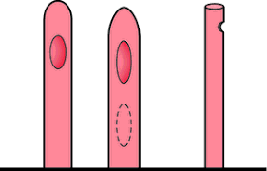
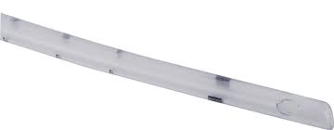
Types of suction catheters
SUCTION
Types of suctioning catheters :
1- Whistle – tipped catheter. 2- Open – tipped catheter.

Slide 19
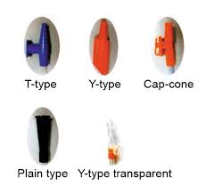
Types of suction catheters
SUCTION
Types of suctioning catheter :

Slide 20
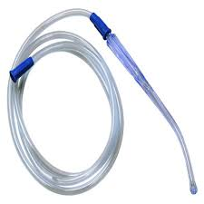
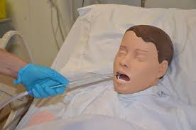
Types of suction catheters
SUCTION
Yankauer Suction Catheter:

Slide 21
Types of suction catheters
SUCTION
Nelaton Suction Catheter:
40 cm long sterile catheter.
Medical PVC material - latex free.
Transparent PVC - allowing urine visibility through it.
Universal color-coded connectors.
Closed rounded tip.

Slide 22
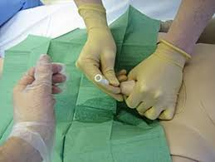
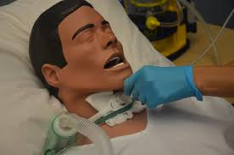
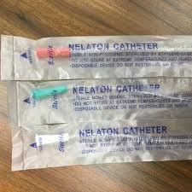
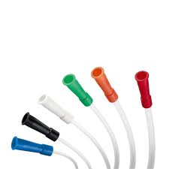
Types of suction catheters
SUCTION
Nelaton Suction Catheter:

Slide 23
RECOMMENDED PRESSURE
SUCTION
Portable Unite | Wall Unit
10 to 15 mm Hg | 100to 120 mm Hg . | Adult
5 to 10 mm Hg | 95 to 110 mm Hg . | Child
2 to 5 mm Hg | 50 to 95 mm Hg . | Infant

Slide 24
EQUIPMENTS
SUCTION
E
Q
U
I
P
M
E
N
T
1- Towel or moisture – resistant pad .
2- Portable or wall suctioning machine with tubing and collection receptor.
3- sterile deposable container for fluids.
4- Sterile normal saline or water.

Slide 25
EQUIPMENTS
SUCTION
E
Q
U
I
P
M
E
N
T
5- Sterile gloves .
6- Goggles or face shield .
7- Sterile Suction Catheter kit .
8- Water – soluble lubricant .
10- sterile gauzes.
11- Moisture resistant disposable bag.
12- Sputum trap .

Slide 26
PROCEDURE
SUCTION
4- position the patient.
Unconscious patient | Conscious patient
Lateral position and the patient facing you . | Semi – Fowler’s position with: head turned to one side for oral suctioning For nasal suctioning with the neck hyperextended.

Slide 27
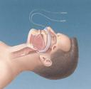

SUCTION

Slide 28
PROCEDURE
5- Prepare the equipment .
6- Make approximate measure of the depth for the insertion of the catheter and test the equipment .
7- Lubricate and introduce the catheter :

Slide 29
  Oropharyngeal suctioning :
SUCTION
    Pull the tongue forward .
    Do not apply suction during insertion .
    Advance the catheter about 10 to 15 cm along on side of the mouth into oropharynx.

Slide 30
  Nasopharyngeal suction
SUCTION
    Advance the catheter along the nasal cavity with out suctioning.
    Never force the catheter against an obstruction .

Slide 31
8- Perform suctioning.
9- Clean the catheter and apply suction again :
    Wipe off the catheter with sterile gauze.
    Flush the catheter with sterile water or saline.
    Relubricate the catheter and repeat suctioning until the air passage is clear.

Slide 32
PROCEDURE
SUCTION
    Allow 20 t0 30 second intervals between each suction and limit suctioning to 5 minutes in total .
    Alternate nares for repeat suctioning.
    Encourage the client to breath deeply and to cough between suctioning .

Slide 33

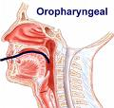
PROCEDURE
SUCTION
10 –Obtain specimen if required.
11- Promote the patient comfort .
12- Dispose of equipment and ensure availability for the next suction .
13- Assess the effectiveness of suctioning .

Slide 34
Hypoxemia
Trauma to the airway
Complications
Nosocomial infection
Cardiac dysrhythmia

Slide 35
HAZARDS COMPLICATIONS
SUCTION
Hypoxia / hypoxemia
Tracheal and / or bronchial mucosal trauma
Cardiac or respiratory arrest
Pulmonary haemorrhage / bleeding
Cardiac dysrhythmias
Pulmonary atelectasis
Bronchoconstriction / bronchospasm
Hypotension / hypertension
Elevated ICP
Interruption of mechanical ventilation

Slide 36


Prevention?
L E A F

Slide 37
Techniques to Minimize or Decrease the Complications
SUCTION
1- Suction only as needed.
2- Sterile technique.
3- Hyperinflation.
4- Hyper oxygenation.
5- Safe catheter size.
6- No saline instillation.

Slide 38
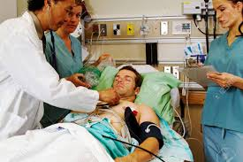
ASSESSMENT OF NEED
SUCTION
Qualified personnel should assess the need for tracheal suctioning as a routine part of
a patient / ventilator system check

Slide 39
NECESSARY EQUIPMENTS ?
SUCTION
Vaccum source with adjustable regulator suction jar
stethoscope
Sterile gloves for open suctioning method
Clean gloves for closed suctioning method
Sterile catheter
Clear protective goggles, apron mask
Sterile normal saline
Bain's circuit or Ambu bag for pre oxygenate the
patient
Suction tray with hot water for flushing

Slide 40
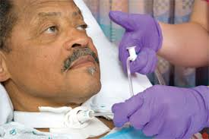
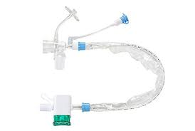
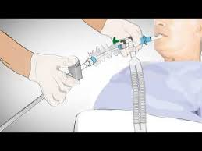
TYPES OF SUCTIONING ?
L E A F
OPEN SUCTION CLOSED SUCTION

Slide 41
TYPES OF SUCTIONING ?
L E A F
OPEN SUCTION SYSTEM
Regularly using system in the intubated patients.
CLOSED SUCTION SYSTEM
This is used to facilitate continuous
mechanical ventilation and oxygenation during the
suctioning.
Closed suctioning is also indicated when PEEP level above 10 cmH2O.

Slide 42
PRE PROCEDURE MONITORING ?
SUCTION
The following should be monitored prior to, during after the procedure
Breath sounds
Oxygen saturation
RR pattern
Haemodynamic parameters (pulse rate, Blood pressure)
Cough effort
ICP (If indicated and available)
Sputum characteristics (colour, volume, consistency odor)
Ventilator parameters (PIP, Vt FiO2)

Slide 43
PATIENT PREPARATION ?
SUCTION
Explain the procedure to the patient (If patient is conscious).
The patient should receive hyper oxygenation by the delivery of 100% oxygen for 30 seconds prior to the suctioning (Either with Bain's circuit or by increasing the FiO2 by mechanical ventilator).
Position the patient in supine position.
Auscultate the breath sounds.

Slide 44
PROCEDURE?
SUCTION
Perform hand hygiene, wash hands. It reduces transmission of microorganisms.
Turn on suction apparatus and set vacuum regulator to appropriate negative pressure.
For adult a pressure of 100-120 mmHg
80-100 mmhg for children
60-80 mmhg for infants.

Slide 45
PROCEDURE?
SUCTION
Goggles, mask apron should be worn to prevent splash from secretions
Preoxygenate with 100% O2
Open the end of the suction catheter package connect it to suction tubing
(If you are alone)
Wear sterile gloves with sterile technique
With a help of an assistant open suction catheter package connect it to suction tubing

Slide 46
PROCEDURE?
SUCTION
With a help of an assistant disconnect the ventilator
Kink the suction tube insert the catheter in to the ET tube until resistance is felt
Resistance is felt when the catheter impacts the carina or bronchial mucosa, the suction catheter should be withdrawn 1 cm out before applying suction

Slide 47
PROCEDURE?
SUCTION
Apply continuous suction while rotating the suction catheter during removal
The duration of each suctioning should be less the 15 sec.
Instil 3 to 5ml of sterile normal saline in to the artificial airway, if required
Assistant resumes the ventilator
Give four to five manual breaths with bag or ventilator

Slide 48
PROCEDURE?
SUCTION
Continue making suction passes, bagging patient between passes, until clear of secretions, but no more than four passes
Return patient to ventilator
Flush the catheter with hot water in the suction tray
Suction nares oropharynx above the artificial airway
Discard used equipments
Flush the suction tube with hot water
Auscultate chest
Wash hands
Document including indications for suctioning
any changes in vitals patients tolerance

Slide 49
Closed suctioning PROCEDURE?
SUCTION
Wash hands
Wear clean gloves
Connect tubing to closed suction port
Pre-oxygenate the patient with 100 O2
Gently insert catheter tip into artificial airway without applying suction, stop if you met resistance or when patient starts coughing and pull back 1 cm out

Slide 50
PROCEDURE?
SUCTION
Place the dominant thumb over the control vent of
the suction port, applying continuous or
intermittent suction for no more than 10 sec as
you withdraw the catheter into the sterile sleeve
of the closed suction device
Repeat steps above if needed
Clean suction catheter with sterile saline until
clear being careful not to instil solution into
the Et tube
Suction oropharynx above the artificial airway
Wash hands

Slide 51
ASSESSMENT OF OUTCOME?
SUCTION
Improvement in breath sounds.
Decreased peak inspiratory pressure Increased
tidal volume delivery during ventilation.
Improvement in arterial blood gas values or
saturation as reflected by pulse oximetry. (SpO2)
Removal of pulmonary secretions.

Slide 52
CONTRAINDICATIONS?
SUCTION
Most contraindications are relative to the
patient's risk of developing adverse reactions or
worsening clinical condition as result of the
procedure.
Suctioning is contraindicated when there is fresh
bleeding.
When indicated, there is no absolute
contraindication to endotracheal suctioning
because the decision to abstain from suctioning
in order to avoid a possible adverse reaction
may, in fact, be lethal.

Slide 53
LIMITATIONS OF METHOD?
SUCTION
Suctioning is potentially an harmful procedure if
carried out improperly.
Suctioning should be done when clinically
necessary (not routinely).
The need for suctioning should be assessed at
least every 2 hrs or more frequently as need arises.

Slide 54
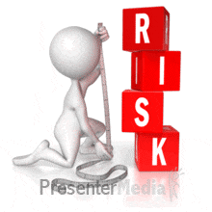
How to assess risk of fall
SUCTION
Notes:
The Morse Fall Scale (MFS) is a rapid and simple method of assessing a patient’s likelihood of falling. A large majority of nurses (82.9%) rate the scale as “quick and easy to use,” and 54% estimated that it took less than 3 minutes to rate a patient. It consists of six variables that are quick and easy to score, and it has been shown to have predictive validity and interrater reliability. The MFS is used widely in acute care settings, both in the hospital and long term care inpatient settings

Slide 55

RISK FACTORS ?
SUCTION

Slide 56
Documentation
  The amount .
  Consistency .
  Color .
  Odor of the mucus .
  Client breathing status before and after suctioning.
Record the
procedure :
If the technique is carried out frequently it may be appropriate to record only once , how ever the frequency of suctioning must be record

Slide 57

Any questions
SUCTION

Slide 58


SUCTION

