Slide 1
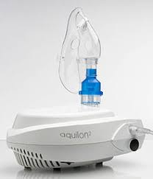
NEBULIZATION THERAPY
IMRAN IQBAL
CLINICAL INSTRUCTOR

Slide 2
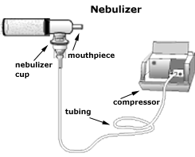
DEFINITION
Nebulization is the process of medication administration via inhalation.
It utilizes a nebulizer which transports medications to the lungs by means
of mist inhalation.

Slide 3
INDICATIONS
Nebulization therapy is used to deliver medications along the respiratory tract
and is indicated to various respiratory problems and diseases such as:
Bronchospasms
Chest tightness
Excessive and thick mucus secretions
Respiratory congestions
Pneumonia
Atelectasis
Asthma

Slide 4
CONTRA-INDICATIONS
In some cases, nebulization is restricted or avoided due to possible untoward results or rather decreased effectiveness such as:
Patients with unstable and increased blood pressure
Individuals with cardiac irritability (may result to dysrhythmias)
Persons with increased pulses
Unconscious patients (inhalation may be done via mask but the therapeutic effect
may be significantly low)

Slide 5
EQUIPMENTS
Nebulizer and nebulizer connecting tubes
Compressor oxygen tank
Mouthpiece/mask
Respiratory medication to be administered
Normal saline solution

Slide 6
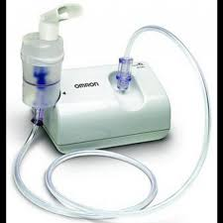
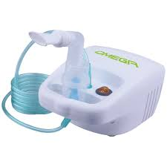
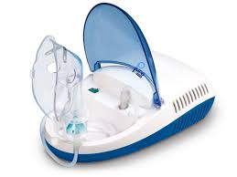
NEBULIZER
WITH CONNECTING TUBE

Slide 7
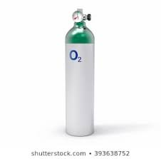
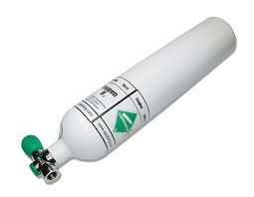
COMPRESSOR O2 TANK

Slide 8
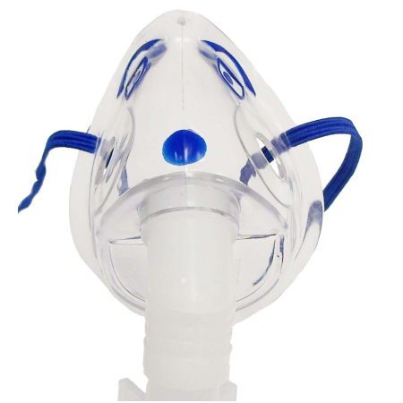
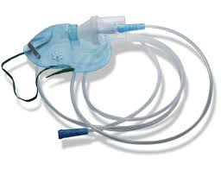
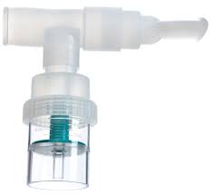
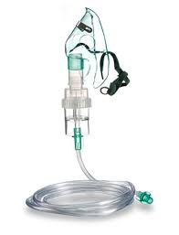
MOUTH PIECE/MASK

Slide 9
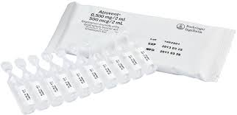
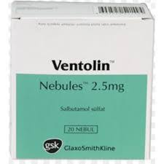
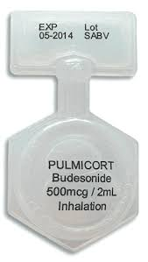
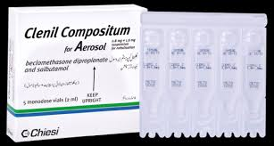
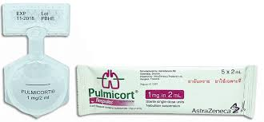
RESPIRATORY MEDICATION

Slide 10
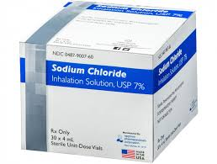
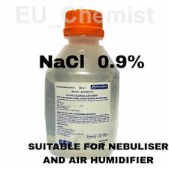
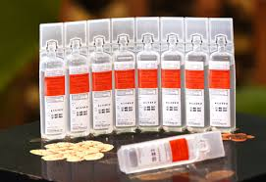
NORMAL SALINE
SOLUTION

Slide 11
PROCEDURE
Position the patient appropriately, allowing optimal ventilation.
Assess and record breath sounds, respiratory status, pulse rate and other significant respiratory functions.
Teach patient the proper way of inhalation:
Slow inhalation through the mouth via the mouthpiece
Short pause after the inspiration
Slow and complete exhalation
Some resting breaths before another deep inhalation

Slide 12
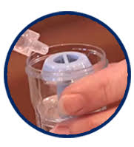
PROCEDURE
Prepare equipments at hand
Check doctor’s orders for the medication, prepare thereafter
Place the medication in the nebulizer while adding the amount
of saline solution ordered.
Attach the nebulizer to the compressed gas source
Attach the connecting tubes and mouthpiece to the nebulizer

Slide 13
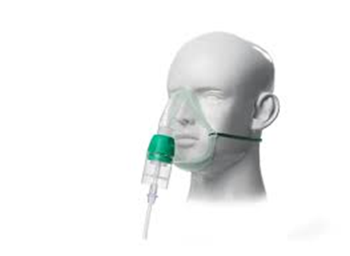
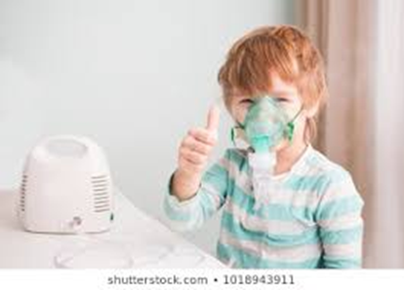
PROCEDURE
Turn the machine on (notice the mist produced by the nebulizer)
Offer the nebulizer to the patient, offer assistance until he is able to perform proper inhalation
(if unable to hold the nebulizer [Pediatric/geriatric/special cases], replace the mouthpiece with mask
Continue until medication is consumed

Slide 14
PROCEDURE
Reassess patient status from:
Breath sounds.
Respiratory status.
Pulse rate and other significant respiratory functions needed.
Compare and record significant changes and improvement.
Refer if necessary
Attend to possible side effects and inhalation reactions

Slide 15
COMPLICATIONS
Possible effects and reactions after nebulization therapy are as follows:
Palpitations
Tremors
Tachycardia
Headache
Nausea
Bronchospasms (too much ventilation may result or exacerbate
bronchospasms)

Slide 16
PATIENT’S TEACHING
As nurses, it is important that we teach the patients the proper way of doing the therapy to facilitate effective results and prevent complications (demonstration is very useful).
Emphasize compliance to therapy and to report untoward symptoms immediately for apposite intervention

Slide 17
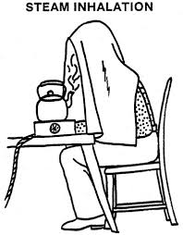
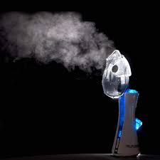
Steam inhalation

Slide 18
DEFINITION
Steam inhalation is one of the most widely used home remedies to soothe and open the nasal passages and get relief from the symptoms of a cold or sinus infection.

Slide 19
EXPLANATION
Also called steam therapy, it involves the inhalation of water vapour.
The warm, moist air is thought to work by loosening the mucus in the nasal passages, throat, and lungs.
This may relieve symptoms of inflamed, swollen blood vessels in your nasal passages.

Slide 20
INDICATIONS
Steam inhalation may provide some temporary relief from the symptoms of:
common cold
The flu (influenza)
Sinus infections (infectious sinusitis)
Bronchitis
Nasal allergies

Slide 21
INDICATIONS
Headache
Congested (stuffy) nose
Throat irritation
Breathing problems caused by airway congestion
Dry or irritated nasal passages
Cough

Slide 22
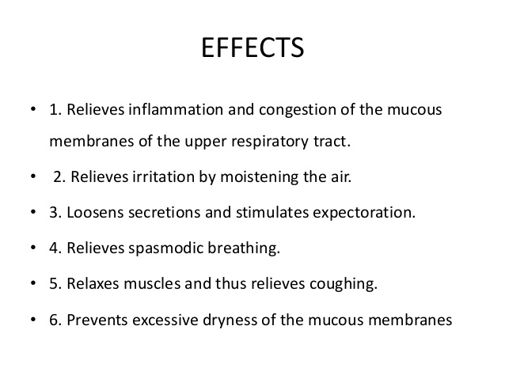

Slide 23
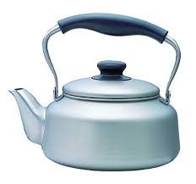
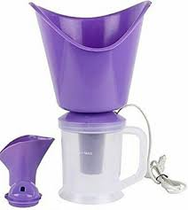
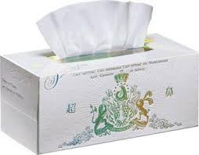
EQUIPMENTS
You’ll need the following materials:
A large bowl
Water
A pot or kettle and a stove or microwave for heating up water
Towel
Bed sheet
Tissue paper

Slide 24
procedure
Heat up the water to boiling.
Carefully pour the hot water into the bowl.
Drape the towel over the back of your head.
Turn on a timer.
Shut your eyes and slowly lower your head toward the hot water until you’re about 8 to 12 inches away from the water. Be extremely careful to avoid making direct contact with the water.
Inhale slowly and deeply through your nose for at least two to five minutes.
Don’t steam longer than 10 to 15 minutes for each session.
However, you can repeat steam inhalation two or three times per day if you’re still having symptoms.

Slide 25
Side effects
Steam inhalation is considered a safe home remedy if done right, but it’s very possible to hurt yourself unintentionally if you’re not careful.
There’s a risk of scalding yourself if you make contact with the hot water.
The biggest risk is accidentally knocking over the bowl of hot water into your lap, which can cause severe burns in sensitive areas.

Slide 26
Side effects
Like many home remedies, always proceed with a grain of salt. What works for one person might not work for you.
If you experience any discomfort, pain, or irritation from using steam therapy, stop using it and look for other ways to alleviate your symptoms.
If you’re feeling under the weather for more than a week or have severe symptoms, make an appointment to see your doctor.

Slide 27
Points to be remember
To avoid burns:
Make sure the bowl of hot water is on a level, sturdy surface and can’t be knocked over.
Don’t shake or lean on the bowl.
Avoid allowing the steam to make contact with your eyes. Your eyes should be closed and
directed away from the steam.
Keep the bowl of hot water out of reach of children or pets.

