Slide 1
Medication Administration

Slide 2
Medication: Concepts
Medications are available in a variety of forms.
The form of the medication determines its route of administration.
The composition of a medication enhances it absorption and metabolism.
Many medications come in several forms so be certain to use the proper form.
Notes:
Nurses need to use knowledge of pharmacokinetics when administering medications, selecting the route of administration, considering the patient’s risk for alterations in medication action, and evaluating the patient’s response.
Four processes are included when considering pharmacokinetics: absorption, distribution, metabolism, and excretion.
For medications to be therapeutic, they must be taken into a patient’s body; be absorbed and distributed to cells, tissues, or a specific organ; and alter physiological functions.

Slide 3
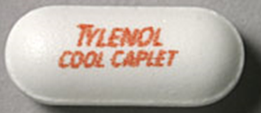
Medication: Forms
Caplet – Shaped like a capsule and coated for easier swallowing
Capsule – powder, liquid or oil in gelatin shell
Tablet – compressed powder
Enteric coated – dissolves in small intestine

Slide 4
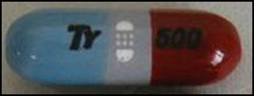
Medication: Forms
Time release – granules with different coatings, or some tablets that dissolve slowly
Lozenge – dissolves in mouth
Elixir – mixed with water or alcohol and
a sweetener
Syrup – Medication dissolved
in a sugar solution

Slide 5
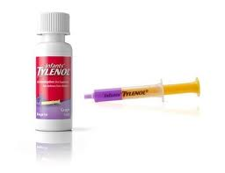
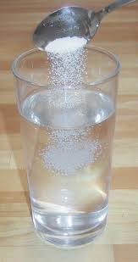
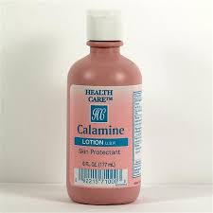
Medication: Forms
Suspension – drug particles in a liquid medium; when left alone will settle in the bottom
Solution – Sterile preparation that contains
water anD one or more dissolved compounds
(IM, SQ, or IV)
Lotion – liquid suspension for skin
Ointment – semisolid (salve another name)

Slide 6
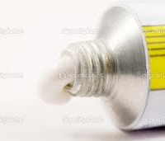
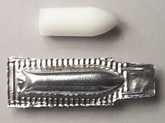
Medication: Forms
Paste – semisolid, but thicker than ointment – slower absorption
Transdermal disk or patch – semi-permeable membrane disk or patch with drug applied to skin
Suppository – solid drug mixed with gelatin inserted into body cavity to melt (rectum or vagina)

Slide 7
Medication: Pharmacokinetics
Route: how enter the body
Absorption: from site into blood
Distribution: from blood into cells, tissues, or organs
Action: how a medication acts
Metabolism: changed to prepare for excretion
Excretion: how they exit the body
This knowledge is used when selecting timing, route, risks, and evaluating the response
Notes:
Absorption is the passage of medication molecules into the blood from the site of medication administration. Factors that influence absorption are the route of administration, ability of the medication to dissolve, blood flow to the site of administration, body surface area (BSA), and lipid solubility of medication.
Each route of medication administration has a different rate of absorption. When applying medications on the skin, absorption is slow because of the physical makeup of the skin. Medications placed on the mucous membranes and respiratory airways are absorbed quickly because these tissues contain many blood vessels. Because orally administered medications pass through the gastrointestinal (GI) tract, the overall rate of absorption is usually slow. Intravenous (IV) injection produces the most rapid absorption because medications are immediately available when they enter the systemic circulation.
Metabolism:
After a medication reaches its site of action, it becomes metabolized into a less active or inactive form that is easier to excrete. Biotransformation occurs under the influence of enzymes that detoxify, break down, and remove biologically active chemicals. Most biotransformation occurs within the liver, although the lungs, kidneys, blood, and intestines also metabolize medications.
Excretion:
The kidneys are the main organs for medication excretion.

Slide 8
Medication: Actions
Therapeutic Effect: expected or predicted physiological response that a medication causes | Side effect: predictable and often unavoidable secondary effects produced at a usual therapeutic dose
Adverse effect: unintended, undesirable, and often unpredictable severe responses to medication | Toxic effect: develop after prolonged intake of a medication or when a medication accumulates in the blood because of impaired metabolism or excretion
Idiosyncratic reaction: Unpredictable. A patient overreacts or underreacts to a medication or has a reaction different from normal | Allergic reaction: Unpredictable. Repeated administration the patient develops an allergic response to it, its chemical preservatives, or a metabolite
Notes:
[When leading this discussion, you can consider developing a matching game or jeopardy-type game.]
Medications vary considerably in the way they act and in their types of action. Patients do not always respond in the same way to each successive dose of a medication. Sometimes the same medication causes very different responses in different patients. Therefore it is essential to understand all the effects that medications have on patients.
Side effects are predictable, and often unavoidable secondary effects are produced at a usual therapeutic dose. They may be harmless or may cause injury. If the side effects are serious enough to negate the beneficial effects of the therapeutic action of the medication, the prescriber discontinues the medication. Patients often stop taking medications because of side effects.
Some adverse effects are immediate, whereas others take weeks or months to develop. Health care providers report adverse effects to the FDA using the MedWatch program.
Toxic effects develop after prolonged intake of a medication, or when a medication accumulates in the blood because of impaired metabolism or excretion. Excessive amounts of a medication within the body sometimes have lethal effects, depending on its action. For example, toxic levels of morphine, an opioid, cause severe respiratory depression and death. Antidotes are available to treat specific types of medication toxicity.
In allergic reactions, the medication or chemical acts as an antigen, triggering the release of antibodies in the body. A patient’s medication allergy symptoms vary, depending on the individual and the medication. Among the different classes of medications, antibiotics cause a high incidence of allergic reactions. Severe or anaphylactic reactions, which are life threatening, are characterized by sudden constriction of bronchiolar muscles, edema of the pharynx and larynx, and severe wheezing and shortness of breath. Immediate medical attention is required to treat anaphylactic reactions.
[See also Table 31-2 on text p. 569 Mild Allergic Reactions.]

Slide 9
Medication: Dose Responses
Serum half-life: Time for serum medication concentration to be halved | Onset: Time it takes after a medication is administered for it to produce a response
Peak: Time at which a medication reaches its highest effective concentration | Trough: Minimum blood serum concentration before next scheduled dose
Duration: Time during which the medication is present in concentration great enough to produce a response | Plateau: Blood serum concentration is reached and maintained
Notes:
Medications administered intravenously enter the bloodstream and act immediately, whereas medications given by other routes take time to enter the bloodstream and have an effect. The quantity and distribution of a medication in different body compartments change constantly. Medications are ordered at various times, depending on when their response begins, becomes most intense, and ceases.
Owing to specific reactions, some medications may need to be evenly administered around the clock to produce maximum effect.
[Refer to Table 31-3 on text page 570 for further explanation regarding medication action.]
The highest level is called the peak concentration, and the lowest level is called the trough concentration. After reaching its peak, the serum concentration of the medication falls progressively. With IV infusions, the peak concentration occurs quickly, but the serum level begins to fall immediately, The time it takes for a drug to reach its peak concentration varies, depending on the pharmacokinetics of the medication.
All medications have a biological half-life, which is the time it takes for excretion processes to lower the amount of unchanged medication by half. A medication with a short half-life needs to be given more frequently than a medication with a longer half-life.
The half-life does not change, no matter how much medication is given.
To maintain a therapeutic plateau, the patient must receive regular fixed doses. For example, current evidence shows that pain medications are most effective when they are given around the clock (ATC) rather than when the patient intermittently complains of pain, because ATC allows the body to maintain an almost constant level of pain medication. After an initial medication dose, the patient receives each successive dose when the previous dose reaches its half-life.
Safe drug administration involves adherence to prescribed doses and dosage schedules.
Some agencies set schedules for medication administration. However, nurses are able to alter this schedule based on knowledge about a medication.
Time-critical medications are medications whose early or delayed administration of maintenance doses more than 30 minutes before or after the scheduled dose most likely will cause harm or will result in subtherapeutic responses in a patient.
Non–time-critical medications include medications in which the timing of administration will most likely not affect the desired effect of the medication if the medication is given 1 to 2 hours before or after its scheduled time. Follow your agency’s medication administration policies about the timing of medications to ensure that you administer medications at the right time.
[Refer to Table 31-3 on text p. 570 for further explanation regarding medication action, and to Table 31-4 on text p. 570 Common Dose Administration Schedules.]

Slide 10
Medication: Dose Responses

Slide 11
Medication: Interactions
Occur when one medication modifies the action of another
A synergistic effect occurs when the combined effect of two medications is greater than the effect of the medications given separately
Notes:
Medication interactions may occur when one medication increases or diminishes the way the other medication is absorbed, metabolized, or eliminated.
Alcohol has a synergistic effect on antihistamines, antidepressants, barbiturates, and narcotics because alcohol is a central nervous system (CNS) depressant.
A patient with hypertension may need to take a combination of medications, such as a diuretic and a vasodilator, to control high blood pressure through the synergistic effect of the two medications.
Some medications increase or diminish the action of others and may alter the way another medication is absorbed, metabolized, or eliminated from the body. When two medications have a synergistic effect, their combined effect is greater than the effect of the medications when given separately. For example, alcohol is a central nervous system depressant that has a synergistic effect on antihistamines, antidepressants, barbiturates, and narcotic analgesics.

Slide 12
Medication: Routes
Oral Sublingual, buccal | Parenteral ID, Sub-Q, IM, IV
Epidural, Intrathecal (brain), Intraosseous (bone), Intraperitoneal (abdomen-ex chemo), Intrapleural (ex. Chemo), Intra-arterial (ex. Clot dissolve) | Topical (ex. Nitro, fentanyl)
Inhalation | Intraocular
Notes:
The route prescribed for administering a medication depends on the properties and desired effect of the medication and the patient’s physical and mental condition.
[Table 31-5 on text p. 571 presents factors influencing administration routes.]
Each of these administration routes has pros and cons. As a nurse, you can help the prescriber decide which route will be most beneficial given the patient’s individual needs.
The oral route is the easiest and the most commonly used route. Oral medications have a slower onset of action and a more prolonged effect than parenteral medications. Patients generally prefer the oral route. (Sublingual and buccal routes are shown on the next slide.)

Slide 13
Medication: Factors Influencing Routes
Oral: convenience vs. tolerance, easy to give, often produces local or systemic effects
Injections: infection risk, needle, bleeding, rapid absorption
Skin/topical: painless, caution w/abrasions, provides local effects
Transdermal: prolonged systemic effects
Mucous membranes: sensitive, less pleasant,
Inhalation: provides rapid effect for local respiratory effect, potential serious side effects

Slide 14
Oral Route
Easiest and most desirable route
Food may decrease therapeutic effect.
Assess patient’s ability to swallow

Slide 15
Oral Route
Sublingual: under tongue
Buccal: inside mouth, cheek area
Notes:
Sublingual administration of a tablet is shown on the left, and buccal administration of a tablet is shown on the right.
Some medications are readily absorbed after being placed under the tongue to dissolve. A medication given by the sublingual route should not be swallowed because the medication does not have the desired effect. Nurses often give nitroglycerin by the sublingual route. Tell the patient not to drink anything until the medication is completely dissolved.
Administration of a medication by the buccal route involves placing the solid medication in the mouth against the mucous membranes of the cheek until it dissolves. Teach patients to alternate cheeks with each subsequent dose to avoid mucosal irritation. Warn patients not to chew or swallow the medication, or to take any liquids with it. A buccal medication acts locally on the mucosa or systemically as it is swallowed in a person’s saliva.

Slide 16
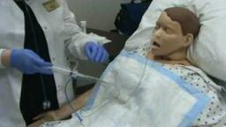
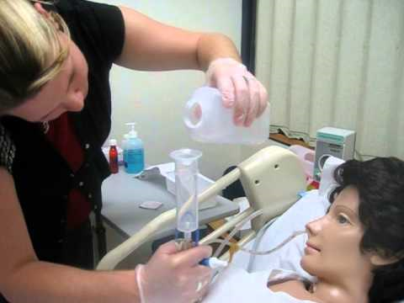
Medication: Nasogastric tube
Liquid form
Dissolve in 15-30 ml. warm water (avoid enteric coated or time release)
Flush tube with 15-30 ml of water between medications
Flush afterwards with 30-60ml
If to suction, clamp 30 min
Notes:
Aspiration precautions
Enteral or small-bore feedings:
Verify that the tube location is compatible with medication absorption.
Follow American Society for Parenteral and Enteral Nutrition (ASPEN) guidelines.
Use liquids when possible.
If medication is to be given on an empty stomach, allow at least 30 minutes before or after feeding.
Risk of drug-drug interactions is higher.
Patients usually are able to ingest or self-administer oral medications with a minimum of problems.
Food delays stomach emptying, which may decrease the therapeutic effects of oral medications.
Protect the patient from aspiration by assessing his or her ability to swallow.
[See also Box 31-14 on text p. 593 Protecting the Patient from Aspiration.]
Special consideration is needed when administering medications to patients with enteral or small-bore feeding tubes.
Failing to follow current evidence-based recommendations from the American Society for Parenteral and Enteral Nutrition (ASPEN) can result in tube obstruction, reduced medication effectiveness, and increased risk of medication toxicity.
When liquid medications are not available, crush simple tablets or open gelatin capsules and dilute in sterile water. Do not use tap water. Tap water often contains contaminants (e.g., pathogens, heavy metals) that can interact with a medication and affect its bioavailability.
If a medication needs to be given on an empty stomach or is not compatible with the feeding, it needs to be held at least 30 minutes before or 30 minutes after medication administration.
Before giving a medication by this route, verify that the location of the tube (e.g., stomach, jejunum) is compatible with medication absorption.
Monitor the patient closely for adverse reactions. The risk for drug-drug interactions is high when two or more medications are given by this route because they can interact as soon as they are administered.
[See also Box 31-15 on text p. 594 Procedural Guidelines: Giving Medications Through an Enteral Tube (Nasogastric Tube, G-Tube, J-Tube, or Small-Bore Feeding Tube.]
Easy and most desirable
Take with 60-100 ml of fluid
Contraindications:
Certain GI alterations
Inability to swallow
Gastric suction
Protect from aspiration – positioning

Slide 17
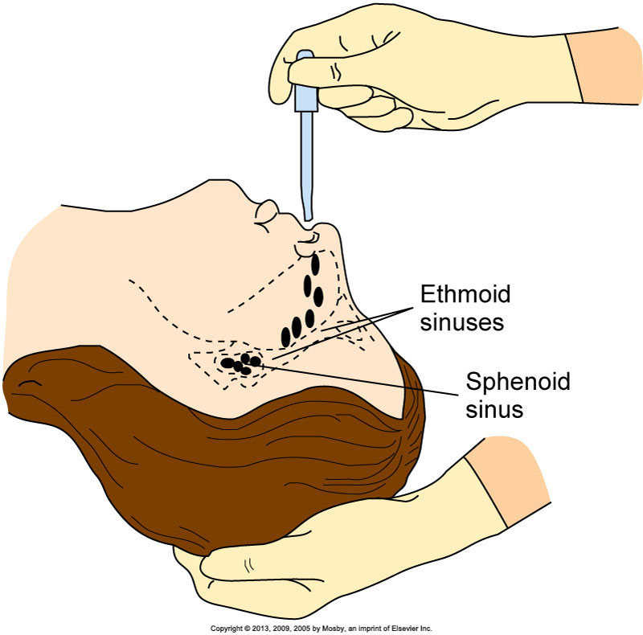
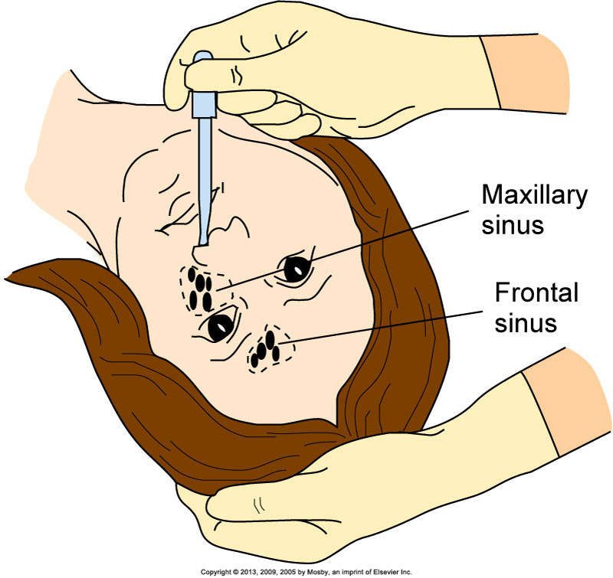
Nasal Instillation
May self-administer
Check nares for irritation
Nasal packing for bleeding and certain surgeries may be used- applied by provider
Notes:
Patients with nasal sinus alterations sometimes receive medications by spray, drops, or tampons.
The most commonly administered form of nasal instillation is decongestant spray or drops, which are used to relieve symptoms of sinus congestion and colds.
Caution patients to avoid abuse of medications because overuse leads to a rebound effect in which nasal congestion worsens.
Saline drops are safer as a decongestant for children than nasal preparations that contain sympathomimetics.
It is easier to have the patient self-administer sprays because he or she is able to control the spray and inhale as it enters the nasal passages. For patients who use nasal sprays repeatedly, check the nares for irritation.
Nasal drops are effective in treating sinus infections.
Position patients to permit the medication to reach the affected sinus.
The left drawing shows positioning to reach the sphenoid and ethmoid sinuses.
The right drawing shows positioning to reach the frontal and maxillary sinuses.
Severe nosebleeds are usually treated with packing or nasal tampons, which are treated with epinephrine, to reduce blood flow. Usually a physician or an advanced practice clinician places nasal tampons.
[See Box 31-16 on text pp. 595-596 Procedural Guidelines: Administering Nasal Instillations, for step-by-step guidelines. Drawings shown are from the procedural guidelines on text p. 596.]

Slide 18
Topical Medications
Eye instillation
Avoid the cornea.
Avoid the eyelids with droppers or tubes to decrease the risk of infection.
Use only on the affected eye.
Never allow a patient to use another patient’s eye medication.
Elderly may have difficulty with drops
Risk of transmitting infection from one eye to the other, do not touch any part of the eye with eye applicator
Apply ointment along lower eyelid, drops into conjunctival sac
Notes:
Medications commonly used by patients include eyedrops and ointments, including over-the-counter (OTC) preparations such as artificial tears and vasoconstrictors.
Many patients, especially older adults, receive prescribed ophthalmic medications for eye conditions such as glaucoma or after cataract extraction. Age-related problems, including poor vision, hand tremors, and difficulty grasping or manipulating containers, affect the older adult’s ability to self-administer eye medications.
Instruct patients and family members about proper techniques for administering them. Determine the patient’s and the family’s ability to self-administer through a return demonstration of the procedure. Showing patients each step of the procedure for instilling eyedrops can improve adherence.
The cornea of the eye has many pain fibers and thus is very sensitive to anything applied to it.
Medications delivered intraocularly resemble a contact lens. Place the medication into the conjunctival sac, where it remains in place for up to 1 week. Patients require teaching about monitoring for adverse reactions to the disk. They also need to know how to insert and remove the disk.

Slide 19
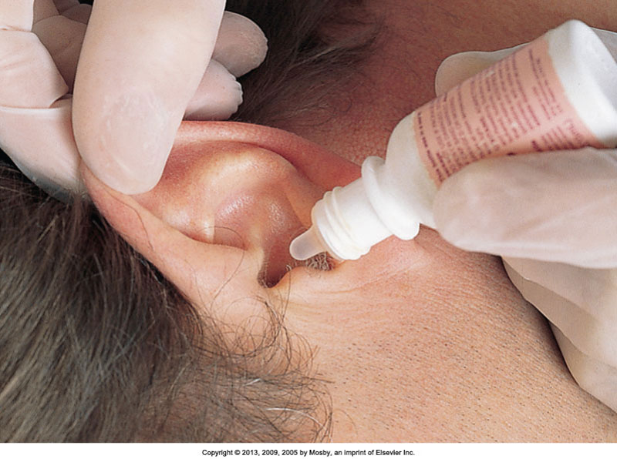
Topical Medications
Ear instillation
Structures are very sensitive to temperature.
Use sterile solutions.
Drainage may indicate eardrum rupture.
Never occlude the ear canal.
Do not force medication into an occluded ear canal.
Notes:
Internal ear structures are very sensitive to temperature extremes. Instill eardrops at room temperature to prevent vertigo, dizziness, or nausea.
Although the structures of the outer ear are not sterile, sterile solutions are used in case the eardrum is ruptured. The entry of nonsterile solutions into middle ear structures can result in infection.
If a patient has ear drainage, be sure that the eardrum has not ruptured. Never occlude or block the ear canal with the dropper or irrigating syringe. Forcing medication into an occluded ear canal creates pressure that injures the eardrum.
The figure shows placement of an eardrop.
[See step-by-step guidelines on p. 597 in the text Box 31-17 Procedural Guidelines: Administering Ear Medications.]
[Shown is the figure from p. 597 in the procedural guidelines.]
Liquid should be at room temperature
If eardrum ruptured, only sterile solutions can be used
Pull auricle up & out (children > 4, adult), down & back (young child)
Side-lying with ear treated facing up

Slide 20
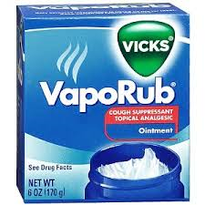
Topical Medications
Skin
Use gloves and applicators.
Use sterile technique if the patient has an open wound.
Clean skin first—remove tissue and crusting.
Apply ointments and pastes evenly.
Follow directions for each type of medication.
Notes:
Topical medications are medications that are applied locally, usually to skin, but also to mucous membranes.
Apply each type of medication according to directions to ensure proper penetration and absorption.

Slide 21
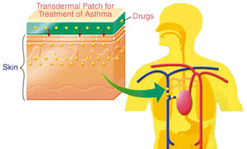
Topical Medications
Transdermal patches:
Remove old patch before applying new.
Document the location of the new patch.
Ask about patches during the medication history.
Apply a label to the patch if it is difficult to see.
Document removal of the patch as well.

Slide 22
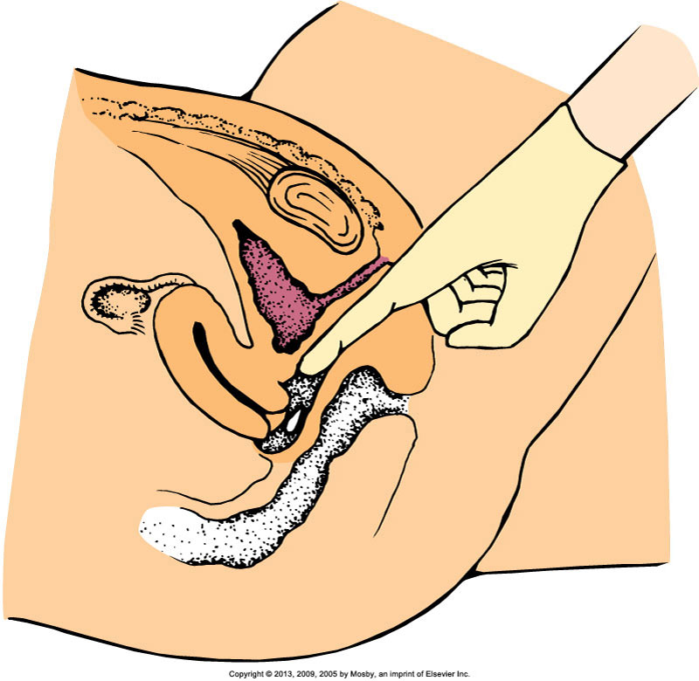
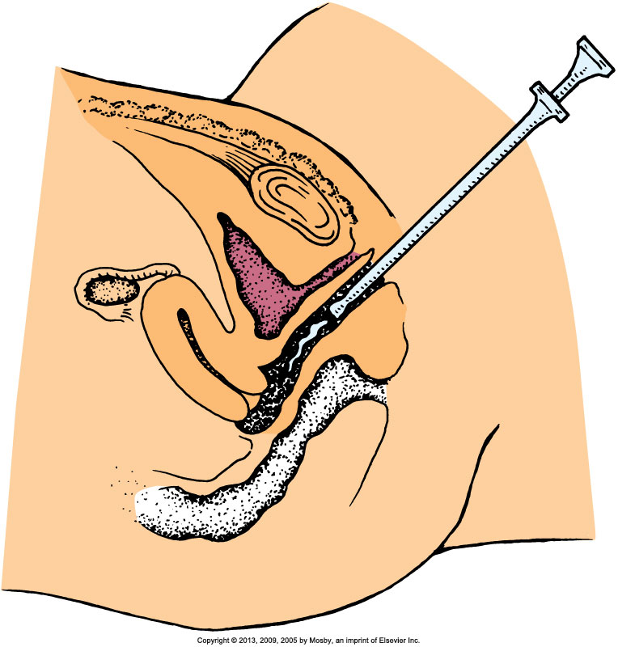
Topical Medications: Vaginal Instillation
Vaginal: use gloves, privacy, patient may choose to self-administer, may need pad to collect any drainage
Notes:
Vaginal medications are available as suppositories, foam, jellies, or creams.
Because vaginal medications are often given to treat infection, discharge is usually foul smelling. Follow aseptic technique, and offer the patient frequent opportunities to maintain perineal hygiene.
Shown on the left is insertion of a suppository into the vaginal canal.
Solid, oval suppositories come individually packaged in foil wrappers and sometimes are stored in the refrigerator to prevent them from melting. After a suppository is inserted into the vaginal cavity, body temperature causes it to melt and be distributed and absorbed.
Give a suppository with a gloved hand in accordance with standard precautions. Patients often prefer administering their own vaginal medications and need privacy.
The diagram on the right shows instillation of medication into the vaginal canal.
Foam, jellies, and creams are administered with an applicator inserter.
[See step-by-step guidelines in Box 31-18 on text p. 598 Procedural Guidelines: Administering Vaginal Suppositories.]
[Shown are the figures from p. 598 in the procedural guidelines.]

Slide 23
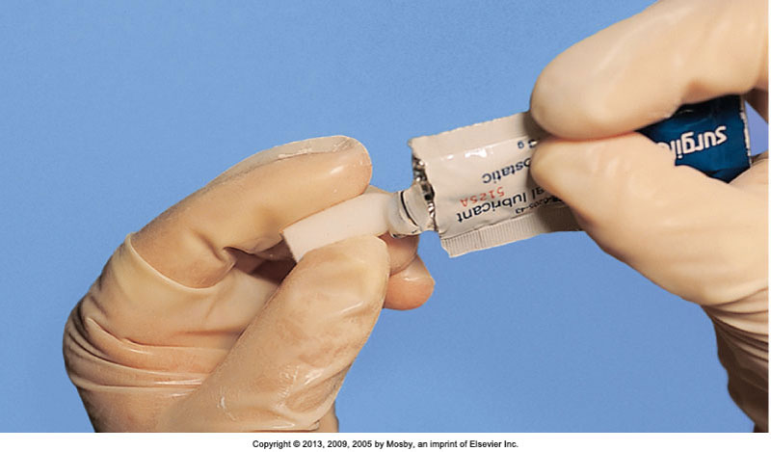
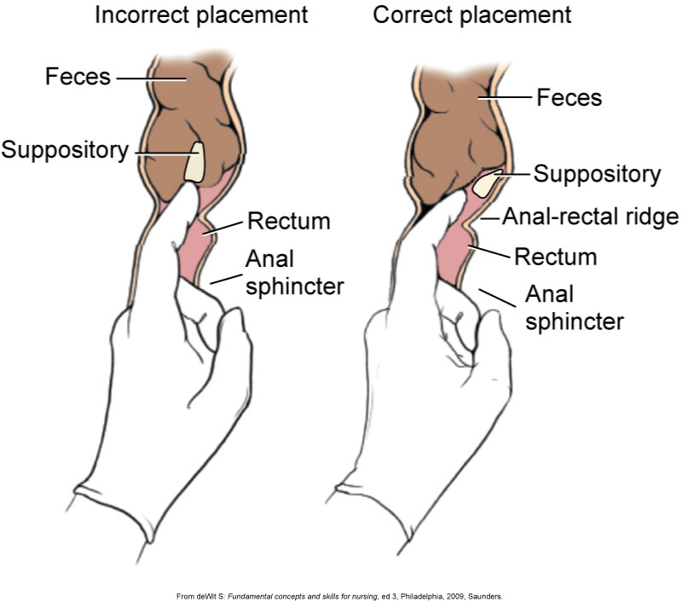
Topical Medications: Rectal Instillation
Rectal:
Gloves, may need lubricant, rounded end to easy administration, place past the internal anal sphincter to prevent expelling, do not force
Notes:
The photo on the left shows removal of a rectal suppository from its wrapper.
Rectal suppositories are thinner and more bullet-shaped than vaginal suppositories. The rounded end prevents anal trauma during insertion.
Rectal suppositories contain medications that exert local effects such as promoting defecation, or systemic effects such as reducing nausea.
Rectal suppositories are often stored in the refrigerator until administered. Sometimes it is necessary to clear the rectum with a small cleansing enema before inserting a suppository.
The diagram shows insertion of a rectal suppository.
[See step-by-step guidelines in Box 31-19 on text p. 599 Procedural Guidelines: Administering Rectal Suppositories.]
[Shown are the figures from p. 599 in the procedural guidelines.]

Slide 24
Administering via Inhalation
Aerosol spray, mist, or powder via handheld inhalers; used for respiratory “rescue” and “maintenance”
Pressurized metered-dose inhalers (pMDIs)
Need sufficient hand strength for use
Breath-actuated metered-dose inhalers (BAIs)
Release depends on strength of patient’s breath.
Dry powder inhalers (DPIs)
Activated by patient’s breath
Produce local effects such as bronchodilation
Some medications create serious systemic side effects.
Notes:
Patients who receive medications by inhalation frequently suffer chronic respiratory disease such as chronic asthma, emphysema, or bronchitis.
Inhaled medications are often described as “rescue” or “maintenance” medications.
Rescue medications are short-acting and are taken for immediate relief of acute respiratory distress.
Maintenance medications are used on a daily schedule to prevent acute respiratory distress. The effects of maintenance medications start within hours of administration and last for a longer time than those of rescue medications.
Because patients depend on inhaled medications for disease control, and current evidence shows that many patients do not use their inhalers correctly, patients need to learn how to self-administer inhalers safely and effectively.
Some patients use a spacer with the pressurized metered-dose inhaler (pMDI). (Breath-actuated metered-dose inhalers [BAIs] and dry powder inhalers [DPIs] do not use spacers.) The spacer is a 4- to 8-inch (10.16- to 20.32-cm)-long tube that attaches to the pMDI and allows the particles of medication to slow down and break into smaller pieces, which improves drug absorption in the patient’s airway. Spacers have a face mask for infants and children younger than 4 years of age. They are especially helpful when the patient has difficulty coordinating the steps involved in self-administering inhaled medications. When patients do not use their inhalers and spacers correctly, they do not receive the full effect of the medication. Therefore, patient education is essential.
One important aspect of patient teaching is to help the patient determine when the MDI, BAI, or DPI is empty and needs to be replaced.
To calculate how long medication in an inhaler will last, divide the number of doses in the container by the number of doses the patient takes per day.

Slide 25
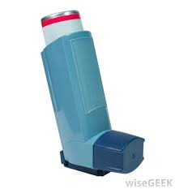
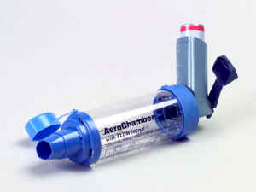
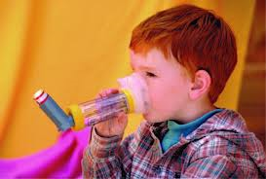
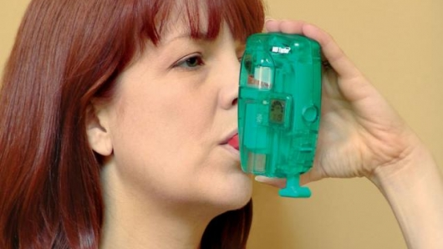
Administering via Inhalation
Inhalers: spacer used when patient unable to do correctly

Slide 26
Administering Injections
Each injection route differs based on the types of tissues the medication enters.
Before injecting, know:
The volume of medication to administer
The characteristics and viscosity of the medication
The location of anatomical structures underlying the injection site
If a nurse does not administer injections correctly, negative patient outcomes may result.
Notes:
The characteristics of the tissues influence the rate of medication absorption and thus the onset of medication action.
Failure to select an injection site in relation to anatomical landmarks results in nerve or bone damage during needle insertion.
Inability to maintain stability of the needle and syringe unit can result in pain and tissue damage.
If you fail to aspirate the syringe before injecting an IM medication, the medication may accidentally be injected directly into an artery or vein.
Injecting too large a volume of medication for the site selected causes extreme pain and results in local tissue damage.

Slide 27
Minimizing Patient Discomfort
Use a sharp-beveled needle in the smallest suitable length and gauge.
Select the proper injection site, using anatomical landmarks.
Apply a vapocoolant spray or topical anesthetic to the injection site before giving the medication, when possible.
Divert the patient’s attention from the injection through conversation using open-ended questioning.
Insert the needle quickly and smoothly to minimize tissue pulling.
Hold the syringe steady while the needle remains in tissues.
Inject the medication slowly and steadily.
Notes:
Many patients, particularly children, fear injections. Patients with serious or chronic illness often are given several injections daily.
Thus it is important to minimize patient discomfort by following the guidelines listed.
Be sure to position the patient as comfortably as possible to reduce muscular tension.
[This list is from text p. 604.]

Slide 28
Injections: Intramuscular
Faster absorption than subcutaneous route
Many risks, so verify the injection is justified
Needles
Very obese: 3 inches; use different route
Thin: ½ to 1 inch
Amounts:
Adults: 2 to 5 mL can be absorbed
Children, older adults, thin patients: up to 2 mL
Small children and older infants: up to 1 mL
Smaller infants: up to 0.5 mL
Notes:
The IM route provides faster medication absorption than the subcutaneous route because of the greater vascularity of muscle. However, IM injections are associated with many risks. Therefore, whenever administering a medication by the IM route, first verify that the injection is justified, meaning that no alternative sites are available. The angle of administration is 90 degrees with larger needle width and length owing to muscle penetration.
Use a longer and heavier-gauge needle to pass through subcutaneous tissue and penetrate deep muscle tissue. Weight and amount of adipose tissue influence needle size selection. For example, a very obese patient often requires a needle 3 inches long, whereas a thin patient requires only a 1/2- to 1-inch needle. Because most agencies have needles that range in length from 3/8 to 1 1/2 inches, investigate different medication routes when IM injections are ordered for patients who are obese.
Muscle is less sensitive to irritating and viscous medications. A normal, well-developed adult patient tolerates 2 to 5 mL of medication into a larger muscle without severe muscle discomfort. However, larger volumes of medication (4 to 5 mL) are unlikely to be absorbed properly. Children, older adults, and thin patients tolerate only 2 mL of an IM injection. Do not give more than 1 mL to small children and older infants, and do not give more than 0.5 mL to smaller infants.

Slide 29
Injections: Intramuscular (cont’d)
Assess the muscle before giving the injection.
Properly identify the site by palpating bony landmarks.
Be aware of potential complications with each site.
The site needs to be free of tenderness.
Aspirate to ensure not in a blood vessel.
Minimize discomfort.
Insertion angle is 90 degrees.
Notes:
Repeated injections in the same muscle cause severe discomfort. With the patient relaxed, palpate the muscle to rule out any hardened lesions. Minimize discomfort during an injection by helping the patient assume a position that helps to reduce muscle strain. Other interventions such as distraction and applying pressure to the IM site decrease pain during an IM injection.
When selecting an IM site, consider the following: Is the area free of infection or necrosis? Are local areas of bruising or abrasions evident? What is the location of underlying bones, nerves, and major blood vessels? What volume of medication is to be administered? Each site has different advantages and disadvantages.
Failure to select injection sites by anatomical landmarks leads to tissue, bone, or nerve damage.

Slide 30
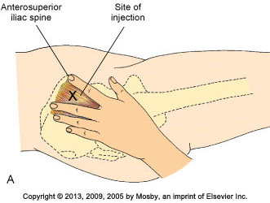
Landmarks: Ventrogluteal IM
Three Landmarks: Greater Trocanter, Anterior iliac spine, iliac crest
Notes:
A, Landmarks for ventrogluteal site. B, Locating ventrogluteal site in patient.
The ventrogluteal muscle involves the gluteus medius; it is situated deep and away from major nerves and blood vessels. This site is the preferred and safest site for all adults, children, and infants, especially for medications that have larger volumes and are more viscous and irritating. The ventrogluteal site is recommended for volumes greater than 2 mL. Research shows that injuries such as fibrosis, nerve damage,
abscess, tissue necrosis, muscle contraction, gangrene, and pain are associated with all common IM sites except the ventrogluteal site.
Locate the ventrogluteal muscle by positioning the patient in a supine or lateral position. Flexing the knee and hip helps to relax this muscle. Place the palm of your hand over the greater trochanter of the patient’s hip with the wrist perpendicular to the femur. Use the right hand for the left hip, and use the left hand for the right hip. Point the thumb toward the patient’s groin and the index finger toward the anterior superior iliac spine; extend the middle finger back along the iliac crest toward the buttock. The index finger, the middle finger, and the iliac crest form a V-shaped triangle; the injection site is the center of the triangle.
[Shown is Figure 31-20A and B from text p. 606.]

Slide 31
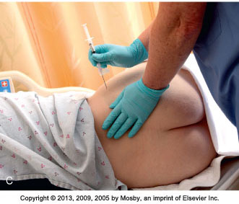
Ventrogluteal IM Injection
Notes:
C, Giving intramuscular injection in ventrogluteal muscle using the Z-track method.

Slide 32
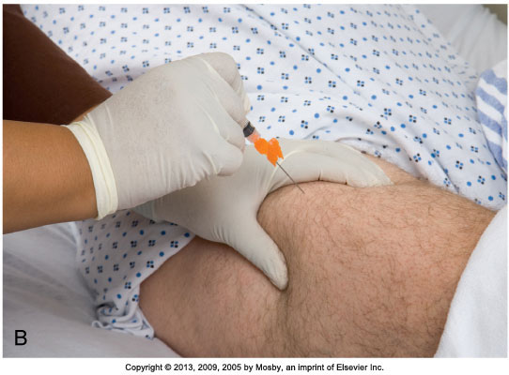
Vastus Lateralis Site for IM Injection
Notes:
A, Landmarks for vastus lateralis site. B, Giving intramuscular injection in vastus lateralis muscle.
The vastus lateralis muscle is another injection site for adults and children. The muscle is thick and well developed, is located on the anterior lateral aspect of the thigh, and extends in an adult from a handbreadth above the knee to a handbreadth below the greater trochanter of the femur.
Use the middle third of the muscle for injection. The width of the muscle usually extends from the midline of the thigh to the midline of the outer side of the thigh. With young children or cachectic patients, it helps to grasp the body of the muscle during injection to be sure that the medication is deposited in muscle tissue. To help relax the muscle, ask the patient to lie flat with the knee slightly flexed or in a sitting position. The vastus lateralis site is often used for infants, toddlers, and children receiving biologicals.
[Shown is Figure 31-21 from text p. 607.]

Slide 33
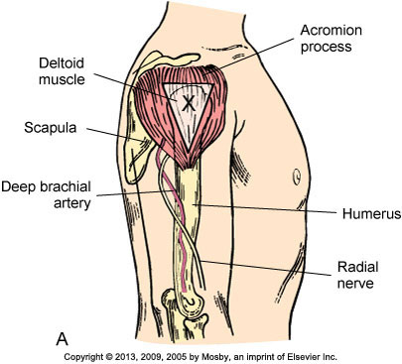
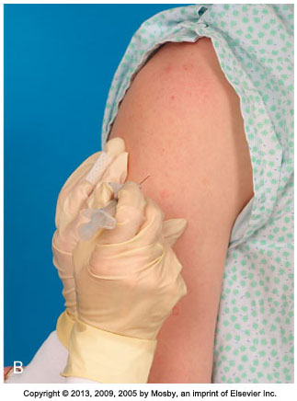
Deltoid Site for IM Injection
Notes:
A, Landmarks for deltoid site. B, Giving intramuscular injection in deltoid muscle.
Although the deltoid site is easily accessible, this muscle is not well developed in many adults. The potential for injury is present because the axillary, radial, brachial, and ulnar nerves, as well as the brachial artery, lie within the upper arm under the triceps and along the humerus. Use this site for small medication volumes (2 mL or less). Carefully assess the condition of the deltoid muscle, consult medication references for suitability of the medication, and carefully locate the injection site using anatomical landmarks.
Use this site only for small medication volumes, when giving immunizations, or when other sites are inaccessible because of dressings or casts. To locate the muscle, fully expose the patient’s upper arm and shoulder. Do not roll up a tight-fitting sleeve. Have the patient relax the arm at the side and flex the elbow. The patient may sit, stand, or lie down.
Palpate the lower edge of the acromion process, which forms the base of a triangle in line with the midpoint of the lateral aspect of the upper arm. The injection site is in the center of the triangle, about 3 to 5 cm (1 to 2 inches) below the acromion process. You can also locate the site by placing four fingers across the deltoid muscle, with the top finger along the acromion process. The injection site is then three fingerwidths below the acromion process.
[Shown is Figure 31-22 from text p. 607.]

Slide 34
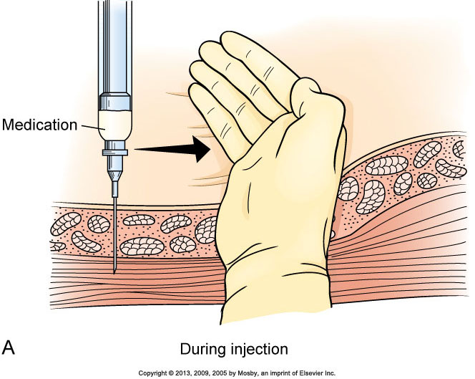
Z-Track Method in IM Injections
Decreases skin irritation & Seals the medicine in
Notes:
A, Pulling on overlying skin during intramuscular injection moves tissue to prevent later tracking. B, Z-track method of injection prevents deposit of medication into sensitive tissue.
It is recommended that, when administering IM injections, the Z-track method be used to minimize local skin irritation by sealing the medication in muscle tissue. The Z-track method for IM injections protects subcutaneous tissues from irritating parenteral fluids.
To use the Z-track method, put a new needle on the syringe after preparing the medication, so no solution remains on the outside needle shaft.
Then select an IM site, preferably in a large, deep muscle such as the ventrogluteal muscle. Place the ulnar side of the nondominant hand just below the site, and pull the overlying skin and subcutaneous tissues approximately 2.5 to 3.5 cm (1 to 1 1/2 inches) laterally or downward. Hold the skin in this position until you administer the injection.
After preparing the site with an antiseptic swab, inject the needle deep into the muscle. Grasp the barrel of the syringe with the thumb and index finger of the nondominant hand, and slowly inject the medication at a rate of 10 seconds per milliliter if no blood return is noted on aspiration. The needle remains inserted for 10 seconds to allow the medication to disperse evenly rather than channeling back up the track of the needle.
Release the skin after withdrawing the needle. This leaves a zigzag path that seals the needle track where tissue planes slide across one another. The medication cannot escape from the muscle tissue. Injections using this technique result in less discomfort and decrease the occurrence of lesions at the injection site.
[Shown is Figure 31-23 from text p. 608.]

Slide 35
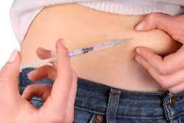
Medication Administration Injections: Subcutaneous
Medication is placed in loose connective tissue under the dermis.
Absorption is slower than with IM injections.
Administering low-molecular-weight heparin requires special considerations.
A patient’s body weight indicates the depth of the subcutaneous layer.
Choose the needle length and angle of insertion based on the patient’s weight and estimated amount of subcutaneous tissue.
Notes:
The subcutaneous route provides medication delivery under loose connective tissue, with minimal vascular supply and increased pain receptor presence. Small needle width and length are required, and administration is best in outer aspects of the deltoids and thighs, as well as in the abdomen. The angle can be 45 or 90 degrees (shown later).
Because subcutaneous tissue is not as richly supplied with blood as the muscles, medication absorption is somewhat slower than with IM injections. Because subcutaneous tissue contains pain receptors, the patient often experiences slight discomfort.
Administration of low-molecular-weight heparin (LMWH) requires special considerations. When injecting the medication, use the right or left side of the abdomen at least 2 inches from the umbilicus (the patient’s “love handles”) and pinch the injection site as you insert the needle. Administer LMWH in its prefilled syringe with the attached needle, and do not expel the air bubble in the syringe before giving the medication. Use U-100 insulin syringes with preattached 25- to 31-gauge needles when giving U-100 insulin, and 1-mL tuberculin syringes when giving U-500 insulin. Recommended sites for insulin injections include the upper arm and the anterior and lateral portions of the thigh, buttocks, and abdomen. Rotating injections within the same body part (intrasite rotation) provides greater consistency in the absorption of insulin. Injections are to be given at least an inch (2.5 cm) away from the previous site. No injection site should be used again for at least 1 month. The rate of insulin absorption varies based on the site; the abdomen has the quickest absorption, followed by the arms, thighs, and buttocks.
Only small volumes (0.5 to 1.5 mL) of water-soluble medications are given subcutaneously because the tissue is sensitive to irritating solutions and large volumes of medications. In children, smaller volumes up to 0.5 mL are given. Collection of medications within the tissues causes sterile abscesses, which appear as hardened, painful lumps under the skin.
Choose the needle length and angle of insertion based on the patient’s weight and an estimation of the amount of subcutaneous tissue. Generally, a 25-gauge, 5/8-inch needle inserted at a 45-degree angle, or a 1/2-inch needle inserted at a 90-degree angle deposits medications into the subcutaneous tissue of a normal-sized patient. Some children require only a 1/2-inch needle. If the patient is obese, pinch the tissue and use a needle long enough to insert through fatty tissue at the base of the skinfold. Thin patients often do not have sufficient tissue for subcutaneous injections; the upper abdomen is usually the best site in this case. To ensure that a subcutaneous medication reaches the subcutaneous tissue, follow this rule: If you can grasp 2 inches (5 cm) of tissue, insert the needle at a 90-degree angle; if you can grasp 1 inch (2.5 cm) of tissue, insert the needle at a 45-degree angle.

Slide 36
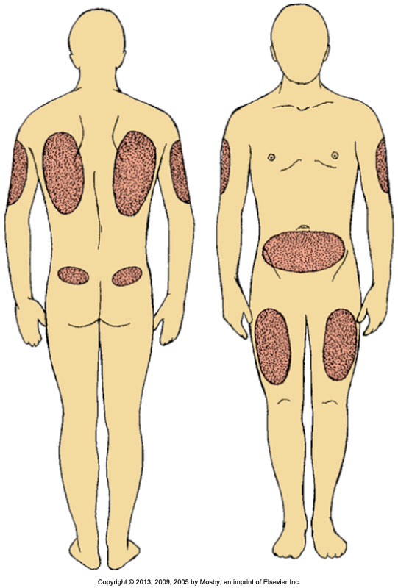
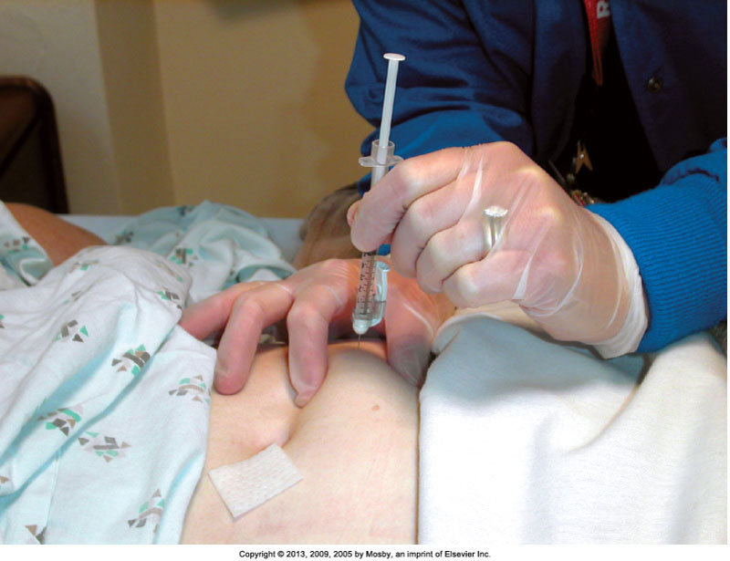
Subcutaneous Injections
Notes:
On the left, the diagram indicates sites recommended for subcutaneous injections.
The photo on the right shows subcutaneous heparin being administered in the abdomen.
The best subcutaneous injection sites include the outer posterior aspect of the upper arms, the abdomen from below the costal margins to the iliac crests, and the anterior aspects of the thighs.
The site most frequently recommended for heparin injection is the abdomen.
Alternative subcutaneous sites for other medications include the scapular areas of the upper back and the upper ventral or dorsal gluteal areas. The injection site chosen needs to be free of skin lesions, bony prominences, and large underlying muscles or nerves.
[Shown are Figures 31-17 and 31-18 from text p. 605.]

Slide 37
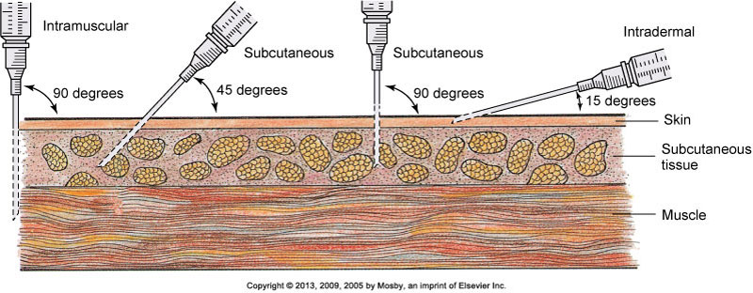
Comparison of Angles of Insertion for Injections
Notes:
Comparison of angles of insertion for intramuscular (90 degrees), subcutaneous (45 to 90 degrees), and intradermal (15 degrees) injections.
[Shown is Figure 31-19 from text p. 605.]

Slide 38
Injections: Intradermal
Used for skin testing (TB, allergies)
Slow absorption from dermis
Skin testing requires the nurse to be able to clearly see the injection site for changes.
Use a tuberculin or small hypodermic syringe for skin testing.
Angle of insertion is 5 to 15 degrees with bevel up.
A small bleb will form as you inject; if it does not form, it is likely the medication is in subcutaneous tissue, and the results will be invalid.
Notes:
Because these medications are potent, they are injected into the dermis, where blood supply is reduced and medication absorption occurs slowly. Sometimes patients have a severe anaphylactic reaction if the medications enter the circulation too rapidly.
Skin testing requires that the nurse be able to clearly see the injection sites for changes in color and tissue integrity. Intradermal sites need to be lightly pigmented, free of lesions, and relatively hairless. The inner forearm and the upper back are ideal locations.
Use a tuberculin or small hypodermic syringe for skin testing.
The angle of insertion for an intradermal injection is 5 to 15 degrees, and the bevel of the needle is pointed up.
As you inject the medication, a small bleb resembling a mosquito bite appears on the surface of the skin. If a bleb does not appear, or if the site bleeds after needle withdrawal, chances are good that the medication entered subcutaneous tissues. In this case, test results will not be valid.

Slide 39
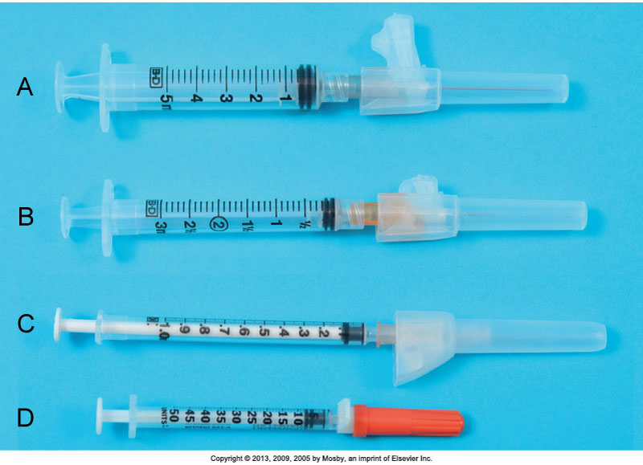
Types of Syringes
Notes:
Types of syringes are shown: A, 5-mL syringe. B, 3-mL syringe. C, Tuberculin syringe marked in 0.01 (hundredths) for doses less than 1 mL. D, Insulin syringe marked in units (50).
The tuberculin syringe (C) is calibrated in sixteenths of a minim and hundredths of a milliliter and has a capacity of 1 mL. Use a tuberculin syringe to prepare small amounts of medications (e.g., intradermal, subcutaneous injections). A tuberculin syringe is useful when small, precise doses are prepared for infants or young children.
Insulin syringes (D) are available in sizes that hold 0.3 to 1 mL and are calibrated in units. Most insulin syringes are U-100s, designed to be used with U-100 strength insulin. Each milliliter of U-100 insulin contains 100 units of insulin.
[Shown is Figure 31-10 from text p. 601.]

Slide 40
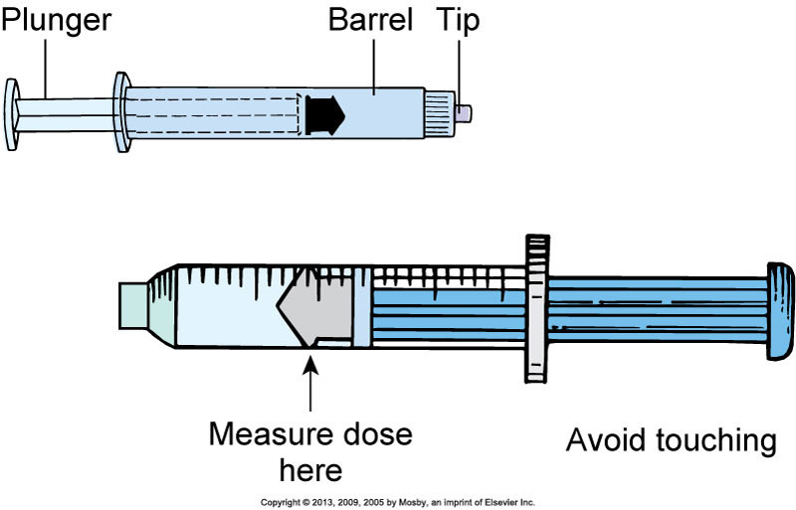
Parts of a Syringe
Notes:
The parts of a syringe are the plunger, barrel, and tip.
Fill a syringe by pulling the plunger outward while the needle tip remains immersed in the prepared solution. Touch only the outside of the syringe barrel and the handle of the plunger to maintain sterility. Avoid letting any unsterile object touch the tip or inside of the barrel, the hub, the shaft of the plunger, or the needle.
[Shown is Figure 31-11 from text p. 601.]

Slide 41
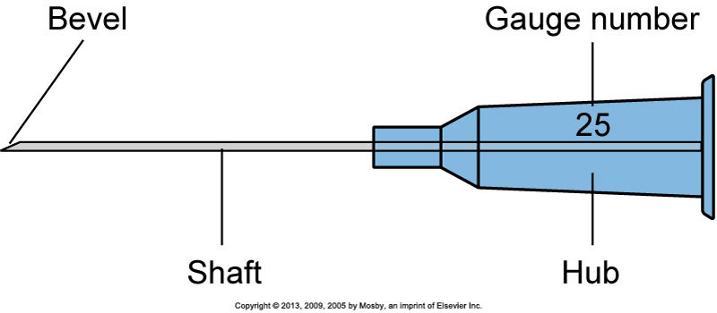
Parts of the Needle
Notes:
A needle has three parts: the hub, which fits onto the tip of a syringe; the shaft, which connects to the hub; and the bevel, or slanted tip.
The tip of a needle, or the bevel, is always slanted. The bevel creates a narrow slit when injected into tissue that quickly closes when the needle is removed to prevent leakage of medication, blood, or serum.
Long beveled tips are sharper and narrower, minimizing discomfort when entering tissue used for subcutaneous or IM injection.
Some needles come packaged in individual sheaths to allow flexibility in choosing the right needle for a patient, whereas others are preattached to standard-sized syringes.
Most needles are made of stainless steel, and all are disposable.
[Shown is Figure 31-12 from text p. 601.]

Slide 42
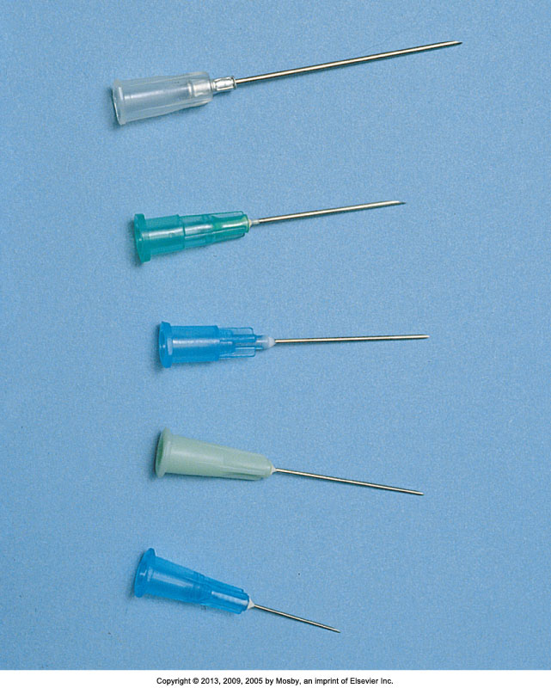
Types of Needles
Notes:
Most needles vary in length from 1/4 to 3 inches.
Top to bottom:
19 gauge, 1 1/2-inch length
20 gauge, 1-inch length
21 gauge, 1-inch length
23 gauge, 1-inch length
25 gauge, 5/8-inch length
Choose needle length according to the patient’s size and weight and the type of tissue into which the medication is to be injected. A child or a slender adult generally requires a shorter needle. Use longer needles (1 to 1 1/2 inches) for IM injections and shorter needles (3/8 to 5/8 inch) for subcutaneous injections.
As the needle gauge becomes smaller, the needle diameter becomes larger. The selection of a gauge depends on the viscosity of fluid to be injected or infused.
[Shown is Figure 31-13 from text p. 601.]

Slide 43
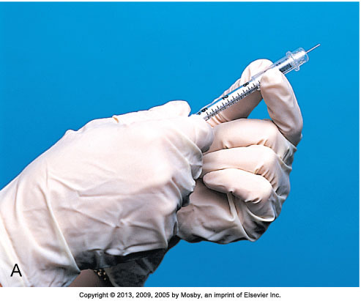
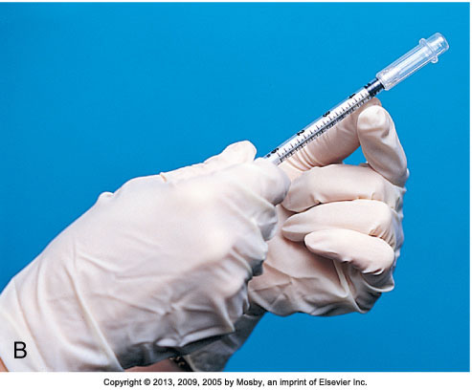
Needle With Plastic Guard
Notes:
Shown is a needle with a plastic guard to prevent needlesticks. A, Position of guard before injection. B, After injection, the guard locks in place, covering the needle.
Safety syringes have a sheath or guard that covers a needle after it is withdrawn from the skin. The needle is immediately covered, eliminating the chance for a needlestick injury. The syringe and the sheath are disposed of together in a receptacle. Use needleless devices whenever possible to reduce the risk of needlestick and sharps injuries.
Always dispose of needles and other instruments considered sharps into clearly marked, appropriate containers. Never place used needles and syringes in a wastebasket, in your pocket, on a patient’s meal tray, or at the patient’s bedside.
[Shown is Figure 31-24 from text p. 608.]

Slide 44
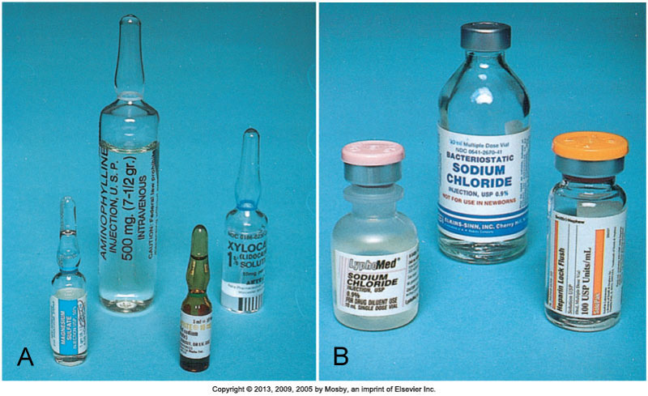
Medication Administration Parenteral
Notes:
On the left (A) are medications in ampules. Ampules contain single doses of medication in a liquid. Ampules are available in several sizes, from 1 mL to 10 mL or more.
An ampule is made of glass and has a constricted neck that must be snapped off to allow access to the medication. A colored ring around the neck indicates where the ampule is prescored, so you can break it easily.
Carefully aspirate the medication into a syringe with a filter needle. Use of a filter needle prevents particulate matter such as small glass fragments or rubber from entering the syringe.
Replace the filter needle with a needle of appropriate size or a needleless access device before administering the injection.
******************************************
On the right (B) are medications in vials. A vial is a single-dose or multidose container with a rubber seal at the top. A metal cap protects the seal until it is ready for use. Vials contain liquid or dry forms of medications. Medications that are unstable in solution are packaged dry. The vial label specifies the solvent or diluent used to dissolve the medication and the amount of diluent needed to prepare a desired medication concentration. Normal saline and sterile distilled water are commonly used to dissolve medications.
Unlike the ampule, the vial is a closed system, and air needs to be injected into it to permit easy withdrawal of the solution. Failure to inject air when withdrawing creates a vacuum within the vial that makes withdrawal difficult. If concerned about drawing up parts of the rubber stopper or other particles into the syringe, use a filter needle when preparing medications from vials.
Some vials contain powder, which is mixed with a diluent during preparation and before injection.
After mixing multidose vials, make a label that includes the date and time of mixing and the concentration of medication per milliliter.
Some multidose vials require refrigeration after the contents are reconstituted.
[Shown is Figure 31-15 from text p. 602.]

Slide 45
Medication Administration Parenteral (cont’d)
If two medications are compatible, they can be mixed in one injection if the total dose is within accepted limits, so the patient receives only one injection at a time.
Mixing medications
Mixing medications from a vial and an ampule
Prepare medication from the vial first.
Use the same syringe and filter needle to withdraw medication from the ampule.
Mixing medications from two vials
Notes:
Most nursing units have charts that list common compatible medications. If any uncertainty exists about medication compatibilities, consult a pharmacist or a medication reference.
When mixing medication from both a vial and a ampule, prepare medication from the vial first. Using the same syringe and filter needle, withdraw medication from the ampule. Nurses prepare the combination in this order because it is not necessary to add air to withdraw medication from an ampule.
Apply these principles when mixing medications from two vials:
1. Do not contaminate one medication with another.
2. Ensure that the final dose is accurate.
3. Maintain aseptic technique.

Slide 46
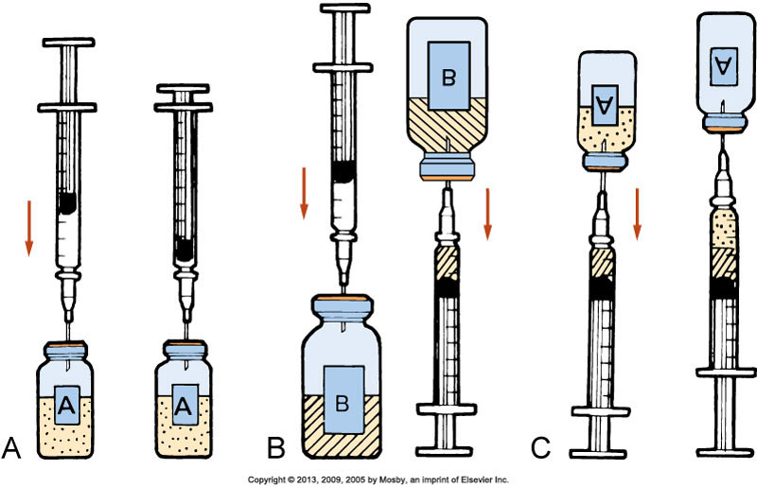
Mixing Medications from Two Vials
Notes:
In (A), the diagram shows injecting air into vial A.
B shows injecting air into vial B and withdrawing dose.
C diagrams withdrawing medication from vial A.
The medications are now mixed.
Use only one syringe with a needle or needleless access device attached to mix medications from two vials.
Aspirate the volume of air equivalent to the dose of the first medication (vial A) (A).
Inject the air into vial A, making sure that the needle does not touch the solution. Withdraw the needle and aspirate air equivalent to the dose of the second medication (vial B) (B).
Inject the volume of air into vial B. Immediately withdraw the medication from vial B into the syringe and insert the needle back into vial A, being careful not to push the plunger and expel the medication within the syringe into the vial.
Withdraw the desired amount of medication from vial A into the syringe (C).
After withdrawing the necessary amount, withdraw the needle and apply a new safety needle or needleless access device suitable for injection.

Slide 47
Insulin Preparation
Insulin is the hormone used to treat diabetes.
It is administered by injection because the GI tract breaks down and destroys an oral form of insulin.
Use the correct syringe:
100-Unit insulin syringe or an insulin pen to prepare U-100 insulin
Insulin is classified by rate of action:
Rapid, short, intermediate, and long-acting
Know the onset, peak, and duration for each of your patients’ ordered insulin doses.
Notes:
Most patients with diabetes who take insulin injections learn to administer their own injections.
In the United States and Canada, health care providers usually prescribe insulin in concentrations of 100 units per milliliter of solution. This is called U-100 insulin. Insulin is also commercially available in concentrations of 500 units per milliliter of solution; this is called U-500 insulin. U-500 insulin is 5 times as strong as U-100 insulin and is used only in rare cases when patients are very resistant to insulin.
Use the correct syringe when preparing insulin. Use a 100-unit insulin syringe or an insulin pen to prepare U-100 insulin. Because no syringe is currently designed to prepare U-500 insulin, many medication errors result with this kind of insulin. When ordering U-500 insulin, ensure that prescribers specify units and volume (e.g., 150 units, 0.3 mL of U-500 insulin) and use tuberculin syringes to draw up the doses. Verify dose with another nurse or pharmacist before administering it to the patient. Additional safety measures common with U-500 insulin include having the insulin listed as being concentrated in computerized medication dispensing systems, making prescribers and pharmacists verify that the patient is to receive U-500 insulin when it is ordered, and stocking only U-500 insulin on patient care units when it is ordered for a specific patient.
To provide safe and effective care, you need to know the onset, peak, and duration for each of your patients’ ordered insulin doses.
Only regular insulin can be given intravenously. Orders for insulin injections attempt to imitate the normal pattern of a patient’s insulin release from the pancreas.
Some insulins come in a stable premixed solution (e.g., 70/30 insulin is 70% NPH [intermediate] and 30% regular), eliminating the need to mix insulins in a syringe. Other patients use an insulin pen. The insulin pen provides multiple doses and allows the patient or nurse to dial in the dose, avoiding the need to use a syringe for insulin preparation.

Slide 48
Mixing Insulins
Patients whose blood glucose levels are well controlled on a mixed-insulin dose need to maintain their individual routine when preparing and administering their insulin.
Do not mix insulin with any other medications or diluents unless approved by the prescriber.
Verify insulin doses with another nurse while preparing them if required by agency policy.
Notes:
Use these principles when mixing insulins.
A patient with diabetes sometimes requires more than one type of insulin. For example, by receiving a short-acting (regular) and an intermediate-acting (NPH) insulin, a patient attains more sustained control of blood glucose levels over 24 hours.
Insulin is ordered by a specific dose at select times. Correction insulin, also known as sliding-scale insulin, provides a dose of insulin based on the patient’s blood glucose level. The term correction insulin is preferred because it indicates that small doses of rapid- or short-acting insulins are needed to correct a patient’s elevated blood sugar. Reliance on correction insulin is unlikely to achieve long-term glucose control; therefore it should be ordered only on a temporary basis.
Before drawing up insulin doses, gently roll all cloudy insulin preparations between the palms of the hands to resuspend the insulin. Do not shake insulin vials; shaking causes bubbles to form. Bubbles take up space in the syringe and alter the dose.
If more than one type of insulin is required to manage the patient’s diabetes, the nurse can mix two different types of insulin into one syringe if they are compatible. If regular and intermediate-acting insulin is ordered, prepare the regular insulin first to prevent the regular insulin from becoming contaminated with the intermediate-acting insulin.
[See Box 31-21 on text p. 603 Example of Correction Insulin Order; and Box 31-22 on text p. 604 Procedural Guidelines: Mixing Two Kinds of Insulin in One Syringe.]

Slide 49
Types of Orders in Acute Care Agencies
Standing or routine: Administered until the dosage is changed or another medication is prescribed | prn: Given when the patient requires it
Single (one-time): Given one time only for a specific reason | STAT: Given immediately in an emergency
Now: When a medication is needed right away, but not STAT | Prescriptions: Medication to be taken outside of the hospital
Notes:
Types of medication orders depend on the urgency, or how frequently they are needed.
A standing order is carried out until the prescriber cancels it by another order, or the prescribed number of days elapses. It often indicates a final date or number of treatments or doses.
A prn order indicates that the prescriber ordered a medication to be given only when a patient requires it.
A STAT order signifies that a single dose of a medication is to be given immediately and only once.

Slide 50
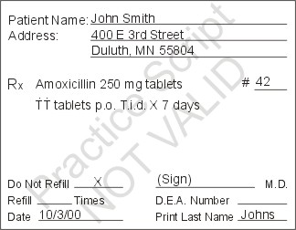
Medication: Orders
Patients full name
Date and time order written
Drug name
Dosage
Route
Time and frequency
Signature of provider
Notes:
#42 Drug Enforcement Agency

Slide 51
Medication Orders - What’s Wrong
Drug + Dose + Route + Time/Frequency
Tylenol 1000mg PO q4 hours prn
Demerol 50mg IM q2 hours prn
Synthroid 0.05mcg 1 tablet
Aspirin 2 tabs prn
Colace 100mg PO BID

Slide 52
Medication Administration
Pharmacist’s role
Prepares and distributes medication
Distribution systems (unit dose or automatic medication dispensing system [AMDS])
Area for stocking and dispensing medication
Nurse’s role
Assess patient’s ability to self-administer, determine whether patient should receive, administer medication correctly, and closely monitor effects; do not delegate this task.
Medication error
Notes:
When administering medications, many health care providers take a role, each with a pivotal part, to ensure that the patient’s safety is maintained.
The pharmacist prepares and distributes prescribed medications. The pharmacist mixes IV solutions. Most medications are delivered in common forms and doses. The pharmacist works with other health care providers to provide information regarding medication side effects, toxicity, interactions, and incompatibilities.
Medications are distributed in many formats. You will want to discuss the formats used by your health care facility. The most common medication administration systems include unit dose and automated medication dispensing systems (AMDSs).
The unit-dose system uses carts containing a drawer with a 24-hour supply of medications for each patient. Each drawer is labeled with the name of the patient and his or her designated room. The unit dose is the ordered dose of medication that the patient receives at one time. [AMDSs are discussed on the next slide.]
The nurse’s role in administering medications is as crucial as those of physicians and pharmacists. Nurses need to ensure that the right medication is ordered, that it is administered correctly, and that it is given on time.
Do not delegate any part of the medication administration process to nursing assistive personnel.
Medication errors can cause the patient harm. [Additional information is discussed in a subsequent slide.]

Slide 53
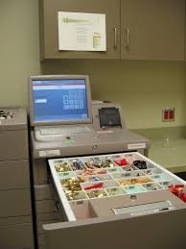
Automated Medication Dispensing System
Automated: control the dispensing of medications, may be networked with computerized medical record, may include controlled substances
Notes:
Shown is an automated medication dispensing system (AMDS).
AMDSs control the dispensing of all medications, including narcotics. Each nurse accesses the system by entering a security code. Some systems require bioidentification as well. With these systems, you place your finger on a screen to access the computer. You select the patient’s name and his or her drug profile before the AMDS dispenses a medication. With these systems, you are allowed to select the desired medication, dosage, and route from a list displayed on the computer screen.
The system causes the drawer containing medication to open, records it, and charges it to the patient. Systems that are connected to the patient’s computerized medical record then record information about the medication (e.g., medication name, dose, time) and the nurse’s name in the patient’s medical record. Some systems require nurses to scan bar codes to identify the patient, the medication, and the nurse administering the medication before recording this information in the patient’s computerized medical record. Agencies that implement AMDS with bar-code scanning often reduce the incidence of medication errors.
[Shown is Figure 31-7 from text p. 582.]

Slide 54
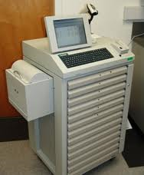
Medication: Administration Systems
Systems for storing and distributing medications
Unit dose: 24 hour supply in drawer for each patient

Slide 55
Medications: Seven Rights
Right patient: 2 identifiers (compare name/ID with MAR)
Right drug: need order, match MAR
Right dose
Right route
Right time: institutional
Right documentation: after it is given
Right to refuse
Notes:
Because nurses play an essential role in preparing and administering medications, they need to be vigilant in preventing errors.
Regardless of how the nurse receives a medication order, he or she compares the prescriber’s written orders with the medication administration record (MAR) or the electronic medication administration record (eMAR) when medication is initially ordered.
When performing medication calculations or conversions, have another qualified nurse check the calculated doses.
An important step in safe medication administration is making sure that you give the right medication to the right patient. Before administering a medication, use at least two patient identifiers.
Always consult the prescriber if an order does not designate a route of administration. Likewise, if the specified route is not the recommended route, alert the prescriber immediately.
You need to know why a medication is ordered for certain times of the day, and whether you are able to alter the time schedule.
A medication order is required for every medication that you administer to a patient. If any question arises about a medication order because it is incomplete, illegible, vague, or not understood, contact the prescribing health care provider before administering the medication.
Never document that you have given a medication until you have actually given it.

Slide 56
Medication: Nurse Role
Follow 7 rights
Read labels 3x and compare to MAR
Use at least 2 patient identifiers
Avoid interruption
Double check calculations, verify with another RN, follow policy
Question unusual doses
Record after medication given
Report errors, near-misses
Participate in programs designed to reduce error
Patient education about medications
Notes:
Because nurses play an essential role in preparing and administering medications, they need to be vigilant in preventing errors.
Regardless of how the nurse receives a medication order, he or she compares the prescriber’s written orders with the medication administration record (MAR) or the electronic medication administration record (eMAR) when medication is initially ordered.
When performing medication calculations or conversions, have another qualified nurse check the calculated doses.
An important step in safe medication administration is making sure that you give the right medication to the right patient. Before administering a medication, use at least two patient identifiers.
Always consult the prescriber if an order does not designate a route of administration. Likewise, if the specified route is not the recommended route, alert the prescriber immediately.
You need to know why a medication is ordered for certain times of the day, and whether you are able to alter the time schedule.
A medication order is required for every medication that you administer to a patient. If any question arises about a medication order because it is incomplete, illegible, vague, or not understood, contact the prescribing health care provider before administering the medication.
Never document that you have given a medication until you have actually given it.

Slide 57
Medication Errors
Report all medication errors.
Patient safety is top priority when an error occurs.
Documentation is required.
The nurse is responsible for preparing a written occurrence or incident report: an accurate, factual description of what occurred and what was done.
Nurses play an essential role in medication reconciliation.
Notes:
A medication error can cause or lead to inappropriate medication use or patient harm. Errors include inaccurate prescribing or administration, or giving a drug via the wrong route or frequency.
It is important to feel comfortable in reporting an error and not fear repercussions from managerial staff. Even when a patient suffers no harm from a medication error, the institution can still learn why the mistake occurred and what can be done to avoid similar errors in the future.
When an error occurs, the nurse first assesses and examines the patient’s condition and notifies the health care provider of the incident as soon as possible. Once the patient is stable, the nurse reports the incident to the appropriate person in the institution (e.g., manager, supervisor).
The nurse is responsible for preparing a written occurrence or incident report that usually needs to be filed within 24 hours of the error. The report includes patient identification information; the location and time of the incident; an accurate, factual description of what occurred and what was done; and the signature of the nurse involved. The occurrence report is not a permanent part of the medical record and is not referred to anywhere in the record. This legally protects the nurse and the institution. Agencies use occurrence reports to track incident patterns and initiate quality improvement programs as needed.
Nurses play an essential role in medication reconciliation. Whenever a nurse admits a patient to a health care setting, he or she compares the medications that the patient took in the previous setting (e.g., home, another nursing unit) with his or her current medication orders. When the patient leaves that setting for another setting (e.g., skilled care facility, intensive care unit), the nurse communicates the patient’s current medications to the health care providers in the new setting. The nurse also reconciles the patient’s medications when he or she is discharged from an agency or is seen in an outpatient setting.
Many agencies have computerized or written forms to facilitate the process of medication reconciliation.
Advances in technology have helped to decrease the occurrence of medication errors.
[Refer to Box 31-4 Steps to Take to Prevent Medication Errors and Box 31-5 Informatics and Medication Safety) on text p. 583 for medication safety information.]
[See also Box 31-6 on text p. 584 Process for Medication Reconciliation.]

Slide 58
Medication Errors: How does it happen?
Inaccurate prescribing
Giving the wrong medication
Using the wrong route
Giving at the wrong time
Extra doses
Omission of scheduled dose

Slide 59
Medication Errors: How does it happen?
Similar drug names (25%)
CeFAZolin vs. Ceftriaxone
Limit verbal orders; follow all procedures
Use only approved abbreviations, symbols
OK to question, clarify, repeat
Occurrence report for errors: nurse’s responsibility, MD informed, within 24 hours, reflect, context, identify factors
Caution with transfers within and between facilities

Slide 60
Medication: Error Prevention
Checking compatibility charts
Checking kidney or liver function & allergies
Never administer drugs prepared or documented by others
Never leave meds at bedside
Open med at bedside – check medication sheet with ID band
Some drugs require 2 nurses to check (insulin, heparin, hyper alimentation, etc.)
Check expiration dates

Slide 61
Nursing Diagnoses
Knowledge deficit regarding drug therapy related to unfamiliarity with information resources
Noncompliance regarding drug therapy related to limited economic resources (or health beliefs)
In effective management of therapeutic regimen related to complexity of drug therapy (or knowledge deficit).
Impaired swallowing related to neuromuscular impairment

