Slide 1
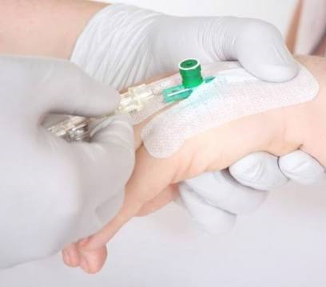
Intravenous
therapy
PREPARED BY:
IMRAN IQBAL
CLINICAL INSTRUCTOR

Slide 2
.
Scope of practice
The infusion nurse is accountable for practicing within the defined scope of practice for the RN and is committed to provide safe and quality infusion nursing care.

Slide 3
.
Scope of practice
The infusion nurse’s practice is based upon the
following:
Knowledge of anatomy and physiology.
Specific knowledge and understanding of the
vascular system and its relationship with other
body systems.
Knowledge of infusion treatment modalities.
Participation in the establishment of the
patient’s ongoing plan of care.

Slide 4
.
Scope of practice
Skills necessary for the administration of IV
therapy. (Latest Technologies)
The infusion nurse should perform nursing
process.
The process should include :-
Assessment.
Problem identification/ Nursing diagnosis.
Outcome identification.
Planning and communication.

Slide 5
.
Scope of practice
Implementation and evaluation.
The infusion nurse should collect:
Data.
Prioritize patient problems and needs.
Develop and implement care plan.
Evaluate patient outcomes.

Slide 6
INDICATIONS OF Intravenous therapy

Slide 7
Indications of
iv therapy
The purpose for IV insertion must be assessed
prior to its insertion.
(Equipments, Site, Patient’s Teaching)

Slide 8
Indications of
iv therapy
Some of the Indications are:
To administer medications.
To replace fluids and electrolytes.
To increase caloric intake when GI tract is not a
viable choice.
Blood and blood products Administration.
To administer TPN ( Total Parental Nutrition)
To Administer diagnostic reagents (e.g. Contrast dyes)
To monitor hemodynamic functions.

Slide 9
ANATOMY OF SKIN AND VEIN

Slide 10
Anatomy of skin and vein
The first barrier to successful peripheral IV insertion is skin.
Barrier between outside environment and internal organs.
The risk for the infection increases whenever skin is broken.
An infusion access device perforates the skin, interrupts the integrity of the barrier and increases the risk of infection.
sterile Technique is very important for IV insertion, care and maintenance.

Slide 11
Anatomy of skin and vein
The Skin consist of two main layers:
1-EPIDERMIS.
The epidermis is the first defence against infection.
It is tough protective layer that contains melanin ( which protects against the rays of the sun and give the skin its colour)

Slide 12
Anatomy of skin and vein
2- DERMIS.
Much thicker and directly below the epidermis.
Dermis layers consists of blood vessels, hair follicles , sweat glands, sebaceous glands, collagen and nerves.
Human skin is only about 0.07 inches (2mm) thick.
About 2 square meter, which weighs about 2.7kg

Slide 13
Anatomy of skin and vein
3-VEIN.
An understanding of the anatomy of vein and venous system will assist the nurse in selecting the appropriate site for IV insertion.
A vein consist of three layers.
Tunica Adventitia. (The outer most layer)
Tunica Media. ( The Middle layer)
Tunica Intima ( The inner most layer)

Slide 14
SELECTION OF VEIN FOR IV INSERTION

Slide 15
Selection OF SITE FOR IV INSERTION
Proper selection of vein is key to successful IV therapy.
Points to be remembered while selecting the site:
Suitable location.
Patient preference.
Amount and type of medication to be infused.
Expected duration of IV therapy.
Accessibility of vein.

Slide 16
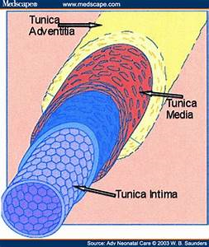

Slide 17
Selection OF SITE FOR IV INSERTION
Size and condition of the vein.
Patient’s age, size, general condition, and
preference.
Presence of disease or surgery (e.g. Mastectomy)
Presence of shunt and graft.
Your experience and skill at venipuncture.
Use a systematic approach ( begin distally and work proximally)
Choose veins which are long, easily palpable and visible.

Slide 18
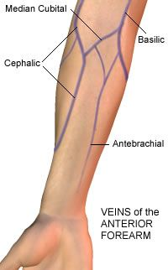

Slide 19
Selection OF SITE FOR IV INSERTION
RENAL PATIENT:
Avoid the extremity with the shunt and graft.
POST MASTECTOMY:
Avoid the operative arm,
Avoid arms with burns, Scars, Paralysis etc.
Avoid cannulation if there is indication of skin infection, pain or trauma.
Avoid veins which are hard with cord-like feeling.

Slide 20
Selection OF SITE FOR IV INSERTION
ELDERLY PATIENT:
Skin on the hands and dorsal metacarpal veins are often fragile, avoid such veins.
LOWER EXTREMITIES:
Are more susceptible to complications ( Doctor’s Ordered required)
Diabetic Patients:
Should never be cannulated on lower extremities.

Slide 21
Selection OF SITE FOR IV INSERTION
JOINTS FLEXION AREAS:
Avoid – it can increase risk of mechanical damage.
Avoid veins close to arteries or arterial lines e.g. antecubital fossa.
Avoid previously cannulated veins- intima may be damaged.
Avoid small, visible but impalpable veins.

Slide 22
equipments

Slide 23
EQUIPMENTS NEEDED FOR
IV cannulation
Followings are the equipments needed for IV cannulation.
IV cannula.
Tourniquet.
Antiseptic Solution (2% Chlorhexidine or
(70% alcohol or 10% Povidone iodine)
Sterile 2-by-2 Gauze.
Saline Flush.
Transparent Dressing / Tape.
IV fluids Bag with tubing.
Volume control device.
Sharp Container.

Slide 24
EQUIPMENTS NEEDED FOR
IV cannulation

Slide 25
EQUIPMENTS NEEDED FOR
IV cannulation

Slide 26
EQUIPMENTS NEEDED FOR
IV cannulation

Slide 27
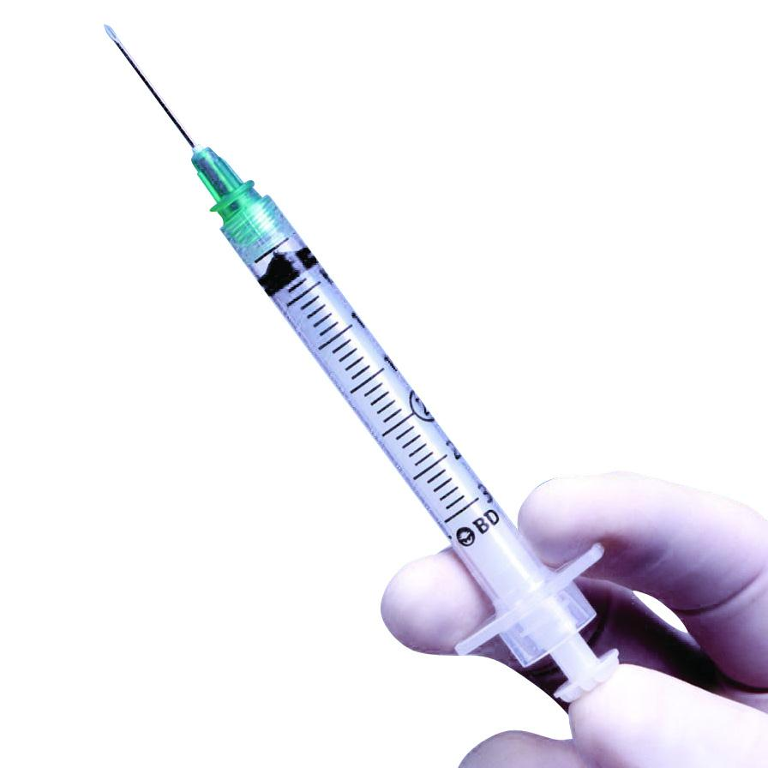
EQUIPMENTS NEEDED FOR
IV cannulation
.
Normal Saline flush

Slide 28
EQUIPMENTS NEEDED FOR
IV cannulation

Slide 29
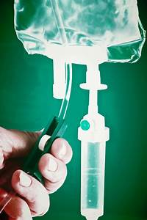
EQUIPMENTS NEEDED FOR
IV cannulation

Slide 30
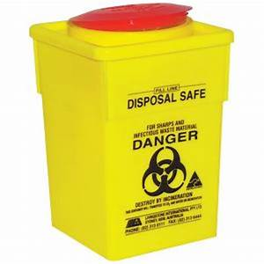
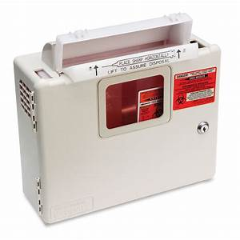
EQUIPMENTS NEEDED FOR
IV cannulation

Slide 31
procedure

Slide 32
PROCEDURE OF PERIPHERAL cannulation
Assemble all the equipments.
Explain the procedure to the Patent.
Prepare the patient for procedure.
Observe universal standard precautions.
Hand washing.
Apply clean gloves.
Assess and choose a vein.
Choose appropriate needle.
If needed clip the hair at site but don’t shave.

Slide 33
PROCEDURE OF PERIPHERAL cannulation
Disinfect the skin at the insertion site.
(circular motion )
Allow the site to dry.
Do not palpate the vein after disinfecting.
Injection lidocaine if needed.
Apply tourniquet, tight enough to distend the vein.
Holding the skin taunt.
Insert the needle or catheter through the subcutaneous tissue at the angle of 10-20 degree.

Slide 34
PROCEDURE OF PERIPHERAL cannulation
As the needle enters the vein assess for blood return indicating successful venipuncture.
If you don’t see blood return, release the tourniquet and discontinue the attempt.
Do not exceed more than two attempts.
If the blood return present, attach the syringe with normal saline and release the tourniquet.
Gently flush the tubing and check for infiltration.
Secure the catheter with transparent occlusive dressing over it.

Slide 35
PROCEDURE OF PERIPHERAL cannulation
Don’t cover the actual insertion site.
Label the IV site with,
Type
Gauge
Date and time of insertion
Initials of the inserting person.
For infants and paediatric patient use a splint or arm board to avoid dislodgement of IV Cannula.
Assess for circulation and prevention of pressure.

Slide 36
MAJOR STEPS IN MAINTAINING PERIPHERAL IV
Double check the physician order.
Check the appropriateness of the solution orders.
Assess the rate to be infused.
Any IV additives should be labelled clearly along with:
Patient’s name
Room Number
Additives name and dosage
Volume per hour

Slide 37
MAJOR STEPS IN MAINTAINING PERIPHERAL IV
Drip rate
Date and time the solution was hung.
Nurses signature
Assemble all the equipments needed
Assess the IV solution to be infused for:
Clarity
Cracks
Leaks
Date of expiry

Slide 38
MAJOR STEPS IN MAINTAINING PERIPHERAL IV
Assess the IV tubing for kinks and tight connections.
Calculate the infusion rate.
Three question must be answered prior to
the rate.
How much solution did the physician order?
Total time of infusion?
What is drop factor of IV tubing ?
Assess the IV site for any signs of local complications.
Documents the procedure.
A peripheral IV has to be discontinued if a physician orders.
If any Complication has occurred at the site.
IV should be changed every 72 hours to avoid phlebitis.

Slide 39
DISCONTINUATION OF PERIPHERAL IV
Procedure:
Check physician’s order.
Wash Hands.
Turn off the IV fluids.
Ensure aseptic techniques.
Put on Non-sterile gloves.
Stabilize the needle with one hand, while removing the dressing.
Gently withdraw the needle at the same angle it was inserted.
Immediately apply pressure with dry sterile gauze till bleeding stops.
Avoid using alcohol swabs, it can delay clotting time.
Assess the site and apply a band aid or dressing .

Slide 40
DISCONTINUATION OF PERIPHERAL IV
Procedure:
Document the procedure and appearance of site.
If the site appears infected, a swab should be taken and sent with tip of the cannula for culture and sensitivity.

Slide 41
DOCUMENTATION

Slide 42
Documentation
Documentation should must contain complete information regarding:
Infusion therapy.
Insertion of peripheral cannula.
Complications.
Adverse reactions.
Documentation must be done according to the organizations guideline.

Slide 43
Documentation
Insertion of iv cannula
Evidence of informed consent.
Reason for insertion of IV cannula.
Date and time.
Details of site preparation.
Numbers of attempts made in insertion of cannula.
Insertion site including name of the vein.
Name of the person placing the cannula.
Problems encountered during insertion.
Appearance of site after insertion, (Bruising/bleeding) Type of Dressing.

Slide 44
Documentation
Insertion of iv cannula
Local anaesthesia used.
Flush solution used/Amount.
Functionality of cannula immediately after insertion, e.g. presence of blood return/ability to flush device easily.
Type, size and gauge of catheter device.
Patient’s response and tolerance to procedure.
Overall condition of the patient.

Slide 45
Documentation of ongoing care / maintenance
Details of catheter care.
Site care and condition.
Appearance (Standardized local assessment scales)
Assessment of insertion site for:
Redness
Edema
Rashes
Discoloration
Drainage
Intactness

Slide 46
Documentation of ongoing care / maintenance
Flush solution, ( Volume, Frequency, Difficulties)
Specify safety and infection control precautions taken.
Catheter replacement.

Slide 47
Documentation of infusion Therapy
Clear and accurate detailed record of IV medication.
Type of therapy administered:
Drug
Rate
Route
Time
Method of administration.

Slide 48
Documentation of infusion Therapy
Pertinent diagnosis
Assessment and monitoring of vital signs
Patient’s tolerance
Response to therapy
Symptoms and appropriate laboratory tests/ results
Record any adverse drug reactions
Any adverse events
Complications of therapy / Peripheral cannula
Record result of any monitoring

Slide 49
Documentation of infusion Therapy
Record site assessment
Record the administration of IV drugs/fluids

Slide 50
Documentation of COMPLICATIONS RELATED IV Therapy
Document any complications.
Side effects of infusion therapy.
Date time and situation when complication was noted.
Complications noted with peripheral cannula.
Strategies used to manage the complications.
Evaluation of effectiveness.
Documentation of extravasations incidents.

Slide 51
Documentation of REMOVAL OF IV CANNULA/ END OF IV Therapy
Date and time of removal.
Procedure used to remove IV cannula.
Any complication during removal.
Catheter length and integrity of catheter on removal
Appearance of site.
Type of dressing applied after removal of cannula.
Reason for removal.
Patient response to removal of cannula.
Discontinuation of therapy.

Slide 52
Documentation
DO’s | DON’Ts
1- Documents only what you observed first hand, what patient said and what was done. 2- “Observed” 3- “No IV related complications” observed. 4- Give details about Complications / nursing interventions, Physician orders, patient comments. 5- Documents catheter length when removing the IV Line. | Opinion . “Noted” “ No redness or swelling” “ Good blood return” “ Patient tolerated the procedure well” “Catheter tip intact”

Slide 53
COMPLICATIONS

Slide 54
Complications OF IV Therapy
Complications of IV therapy may be classified as:
Localized:
Which occur more frequently but are less
serious.
Systemic:
Which although rare, may be life
threatening, and require treatment.

Slide 55
Localized Complications
1- INFILTRATION
2- EXTRAVASATIONS
3- PHLEBITIS
4- HEMATOMA
5- CELLULITES

Slide 56
Localized Complications

Slide 57
1- INFILTRATION
An infiltration is a significant leakage of IV fluid or blood into the extravascular tissues.
It is the most common complication of IV therapy.
ETIOLOGY:
Puncture of the distal vein wall during access.
Puncture of the wall by mechanical friction.
Dislodgement of the catheter from the intima of the vein.
Poor securement.

Slide 58
1- INFILTRATION
High delivery rate.
Over manipulation.
SIGN AND SYMPTOMS:
Coolness of the skin around site.
Taut skin.
Tenderness.
Dependant oedema.
Absence of blood return.
“Pinkish” blood return.
Infusion rate slow.

Slide 59
1- INFILTRATION
INTERVENTIONS:
Stop infusion immediately.
Remove the cannula.
Elevate the effected arm.
Assess degree of infiltration ( Infiltration scale)
If the complication has been ½ hour of infiltration and oedema is minimal, Apply ice to reduce further oedema.
Moist heat will help to facilitate absorption of fluid.

Slide 60
1- INFILTRATION SCALE
GRADES | CLINICAL CRITERIA
0 | No sign or symptoms
1 | Skin blanched Edema 2.5 cm in any direction Cool to touch With or without pain
2 | Skin blanched Edema 2.5 – 1.5 cm in any direction Cool to touch With or without pain
3 | Skin blanched, translucent Gross edema 15 cm in any direction Cool to touch Mild to moderate pain Possible numbness

Slide 61
1- INFILTRATION SCALE
GRADES | CLINICAL CRITERIA
4 | Skin blanched, translucent Skin tight, leaking Skin discoloured, bruised, swollen Gross edema >6 inches in any direction Deep pitting tissue edema Circulatory impairment Moderate to severe pain Infiltration of any amount of blood product, irritant, or vesicant

Slide 62
PREVENTION
Stabilization of site after IV insertion.
Avoidance of insertion over joints.
Insertion of small lumen cannula.
Regular inspection of IV insertion site:
1 Hourly for continuous vesicant or irritant solutions
4 Hourly for continuous non-irritant fluids.

Slide 63
PREVENTION

Slide 64
PREVENTION

Slide 65
PREVENTION

Slide 66
EXTRAVASATIONS
Extravasations is the leakage of IV drugs from the vein into the surrounding tissues.
It tends to relate to the leakage of vesicant drugs increasing the potential for injury.(sodium bicarbonate, 10% Glucose, KCL )
ETIOLOGY:
Same as infiltration.

Slide 67
EXTRAVASATIONS
TREATMENT:
Local policies for treating extravasations vary, often according to speciality, age group, and vesicant.
Common treatments vary from wound exposure, occlusive dressing, ration with antidote.
Plastic surgery.
PREVENTION:
Same precautions as infiltration.
The nurse should documents complication at each stage to protect themselves legally.

Slide 68
PHLEBITIS

Slide 69
PHLEBITIS
Phlebitis is an acute inflammation of a vein directly linked to the presence of any vascular device.
Phlebitis is the most common complication of IV therapy.
ETIOLOGY:
Phlebitis can be classified into:
Mechanical Phlebitis.
Cannula Causes trauma to the intimal wall of the vessel.
Chemical Phlebitis.
Composition, Concentration and Increased pH causes damage to endothelium.
Infective Phlebitis.
When Tip of the cannula is infected (Asepsis procedure breached)

Slide 70
PHLEBITIS
SIGN AND SYMPTOMS:
Slow onset of tender red area.
Superficial vein on the skin.
The area may feel hard, warm, and tender.
Low-grade fever.
Edema.
Sluggish flow rate.
SIGN AND SYMPTOMS:
Remove the cannula.
Apply warm compression.
Elevate the extremity (if edema present)

Slide 71
PHLEBITIS
PREVENTION:
Firm stabilization of infusion devices.
Adequete dilution of irritating additives.
Administration of compatible drug additives.
Use small gauge needle for administering caustic drugs.
Avoid cannulation over joints.
Consider re-sting the cannula every 72-96 hours.
Replace the cannula at first indication of phlebitis.

Slide 72
PHLEBITIS Scale

Slide 73
Haematoma

Slide 74
Haematoma
Haematoma is seepage of blood into extravascular tissue.
ETIOLOGY:
Related to venipuncture technique.
Use of large bore cannula (Trauma to the vein during insertion)
Patient receiving Anticoagulant therapy.
Long term steroids therapy.
D/C IV without applying the adequate pressure.
Applying the tourniquet too tightly above a previously attempted venipuncture site.

Slide 75
Haematoma
SIGNS AND SYMPTOMS:
Discoloration of the skin.
Site swelling and discomfort.
Inability to advance the cannula all the way.
Resistance to positive pressure during the lock flushing .
TREATMENT:
Stop the infusion and remove the catheter.
Apply positive pressure till bleeding stops.

Slide 76
Haematoma
PREVENTION:
Use of indirect method
Apply tourniquet just before venipuncture.
On successful cannulation, release the tourniquet before opening the flow.
Use the small needles in elderly and patients with thin skin and on steroids.
Use blood pressure cuff to apply pressure.
Be gentle.

Slide 77
CELLULITES

Slide 78
CELLULITES
Infection of venipuncture site is result of a break in aseptic technique.
ETIOLOGY:
Commonly involved organisms are transferred through poor aseptic techniques:
Staphylococcus aureus
klebsiella
Serratia.
Pseudomonas aeruginosa.
Use of contaminated equipments.

Slide 79
CELLULITES
Infection of venipuncture site is result of a break in aseptic technique.
SIGNS AND SYMPTOMS:
The site appears red, sore, and oedematous.
Discharge that is purulent and foul smelling.
TREATMENT:
Remove the cannula immediately.
Catheter tip and swab should be cultured.
Clean the site with povidone and apply sterile dressing.

Slide 80
CELLULITES
PREVENTION:
Re-siting peripheral IV every 96 hours (Different extremity)
Strict aseptic techniques.
Assess IV solution for sign of contamination prior to use.
Change the IV tubing every 24 – 48 hours.
(follow organizations policies and procedures)
Change the IV dressing whenever it is wet or moist.

Slide 81
SYSTEMIC COMPLICATIONS
1- SEPTICAEMIA
2- CIRCULATORY OVERLOAD
3- AIR EMBOLISM
4- SPEED SHOCK

Slide 82
septicemia
Septicaemia is systemic infection in the blood stream.
ETIOLOGY:
Poor aseptic technique during insertion, infusion, or maintenance.
SIGNS AND SYMPTOMS:
Sudden rise in body temperature.
Chills.
Tachycardia.
hypotension.

Slide 83
septicemia
TREATMENT:
Discontinue IV immediately.
Send all equipments to Lab for culture.
Assess patient for any other source of infection like sputum,
blood, urine.
Treat with broad spectrum antibiotics.
PREVENTION:
Re-siting IV every 48-72 hours (Different Extremity)
Re-siting peripheral IV every 96 hours (Different extremity)
Strict aseptic techniques.
Assess IV solution for sign of contamination prior to use.
Change the IV tubing every 24 – 48 hours.
(follow organizations policies and procedures)
Change the IV dressing whenever it is wet or moist.

