Slide 1
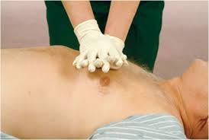
BASIC LIFE SUPPORT
(BLS)

Slide 2
INTRODUCTION
WELCOME
To the basic Life Support ( BLS) provider course.
Prepared by:
IMRAN IQBAl
CLINICAL EDUCATOR

Slide 3
Chain of Survival
Adult

Slide 4
Chain of Survival
Adult
OHCA

Slide 5
BLS FOR ADULTS
Learning objectives
At the end of this part, you will be able to
Recognize the signs of someone needing CPR
Perform high-quality CPR for an adult
Provide effective ventilations by using a barrier device

Slide 6
BLS FOR ADULT
CPR consist of these main components,
Chest Compressions
Airway
Breathing
MAIN COMPONENTS OF CPR

Slide 7
BLS FOR ADULT
MAIN COMPONENTS OF CPR

Slide 8
BLS FOR ADULT
Introduction
If the rescuer is alone and encounters an unresponsive adult
1-RESCUER BLS sequence

Slide 9
BLS FOR ADULT
Verify Scene Safety
Verify that the scene is safe for you and the victim.
you do not want to become a victim yourself.
1-RESCUER BLS sequence

Slide 10
BLS FOR ADULT
Check for responsiveness
Check for responsiveness.
Tap the victim’s shoulder and shout “Are you OK”.
If the victim is not responsive, shout for nearby help.
1-RESCUER BLS sequence

Slide 11
BLS FOR ADULT
Activate the emergency response
Activate the emergency response system as appropriate
(follow Hospital protocol)
If you are alone, get the AED and emergency equipment.
If someone else available send that person to get it.
1-RESCUER BLS sequence

Slide 12
BLS FOR ADULT
Assess for Breathing and Pulse
Assess the victim for normal breathing and a pulse, This will help you
determine the next appropriate action.
To minimize the delay in starting CPR, you may assess breathing
at the same time as you check the pulse.
This should not take more than 10 seconds.
1-RESCUER BLS sequence

Slide 13
BLS FOR ADULT
Breathing
To check for breathing, scan the victim’s chest for rise and
fall for no more than 10 seconds.
If the victim is breathing, monitor the victim until additional
help arrives.
If the victim is not breathing or only gasping, this is not considered normal breathing and is a sign of cardiac arrest.
1-RESCUER BLS sequence

Slide 14
BLS FOR ADULT
Carotid Pulse
Locate the trachea ( on the side closest to you) using 2 or 3 fingers.
Slide these 2 or 3 fingers into the groove between the trachea and the muscles at the side of the neck, where you can feel the carotid pulse.
Feel for a pulse for at least 5 seconds but no more than 10 seconds.
if you do not definitely feel a pulse, begin CPR, starting with chest
compressions.
Locating the carotid pulse

Slide 15
BLS FOR ADULT
Attempt defibrillation with AED
Use the AED as soon as it is available, and follow the prompts
Resume High-quality CPR
Immediately resume high-quality CPR, starting with chest compressions, when advised by the AED.
Continue to provide CPR, and follow the AED prompts until advanced life support is available.

Slide 16
BLS FOR ADULTS
The foundation of CPR is chest compression.
Follow these step to perform chest compression
1-Position yourself at the victim’s side.
2- Make sure that victim is lying on faceup on a firm, flat surface.
3- If the victim is lying facedown, carefully roll him faceup.
4- If you suspect the victim has a head or neck injury, try to keep the head, neck and torso in a line when rolling the victim to a faceup position.
CHEST COMPRESSION TECHNIQUES

Slide 17
BLS FOR ADULTS
5- Position your hands and body to perform chest compression.
Put the heel of one hand in the centre of the victim’s chest, on the
lower half of breastbone. (Sternum)
Put the heel of your other hand on top of the first hand.
Straighten your arms and position your shoulders directly over your
hands.
CHEST COMPRESSION TECHNIQUES

Slide 18
BLS FOR ADULTS
5- Give chest compression at a rate of 100 to 120/min.
6- Press down at least 5 cm with each compression .
7- For each chest compression , make sure you push straight down on the victim’s breastbone.
8- At the end of each compression, make sure you allow the chest to recoil completely.
9- Minimize interruptions of chest compressions.
CHEST COMPRESSION TECHNIQUES

Slide 19
BLS FOR ADULTS
ADULT BREATHS
OPENING THE AIRWAY
For breaths to be effective, the victim’s airway must be open.
Two methods for opening the airway are
Head tilt-Chin lift. To open the airway if no head or neck injury.
Jaw thrust. Use if head or neck injury suspected, switch to head tilt-chin lift maneuver if the jaw thrust does not open the airway

Slide 20
BLS FOR ADULTS
ADULT BREATHS
HEAD TILT- CHIN LIFT STEPS.
Follow these steps to perform head tilt- chin lift.
Place one hand on the victim’s forehead and push with your palm to tilt the head back.
Place the fingers of the other hand under the bony part of the lower jaw near chin.
Lift the jaw to bring the chin forward.

Slide 21
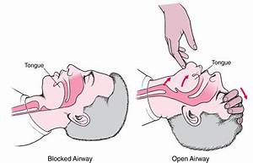
BLS FOR ADULTS
ADULT BREATHS
HEAD TILT- CHIN LIFT.

Slide 22
BLS FOR ADULTS
ADULT BREATHS
JAW THRUST STEPS.
Follow these steps to Perform a jaw thrust.
Place one hand on each side of the victim’s head, you may rest your elbows on the surface which the victim is lying.
Place your fingers under the angles of the victim’s lower jaw and lift with both hands, displacing the jaw forward.
If the lips close, push the lower lip with your thumb to open the lips.

Slide 23
BLS FOR ADULTS
ADULT BREATHS
JAW THRUST.

Slide 24
BLS FOR ADULT
Barrier devices
POCKET MASK.
For mouth to mask use pocket mask.
Pocket masks usually have a 1-way valve, which diverts exhaled air, blood
or bodily fluids away from rescuer.
1-way valve allow the rescuer’s breath to enter the victim’s mouth and nose and diverts the victim’s exhaled air away from rescuer.
Some pocket masks have oxygen inlet for supplementary oxygen

Slide 25
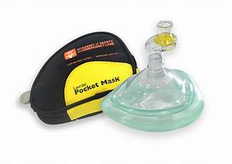
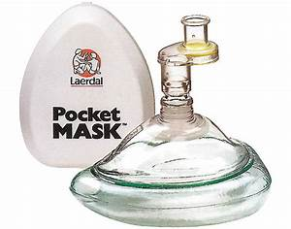
BLS FOR ADULT
Barrier devices
POCKET MASK.

Slide 26
BLS FOR ADULT
Barrier devices
USE OF POCKET MASK.
Position yourself at victim’s side.
Place the pocket mask on the victim’s face, using the bridge of the nose as a guide for correct position.
Seal the pocket mask against the face.
Using your hand that is closer to the top of the victim’s head, Place the index finger and thumb along the edge of the mask.

Slide 27
BLS FOR ADULT
Barrier devices
USE OF POCKET MASK.
Place the thumb of your other hand along the edge of the mask.
Place remaining fingers of your second hand along the bony margin of the
jaw and lift the jaw, perform a head tilt-chin lift to open the airway.
while you lift the jaw, press firmly and completely around the outside edge of the mask to seal the pocket mask against the face.
deliver each breath over 1 second, enough to make the victim’s chest rise.

Slide 28
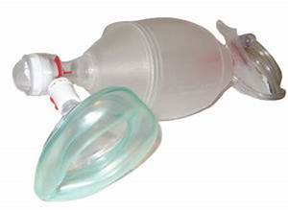
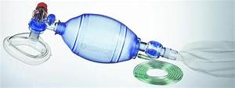
BLS FOR ADULT
Barrier devices
BAG-MASK DEVICE.
A bag-mask device used to provide positive pressure ventilation to a victim who is not breathing normally.
It consist of a bag attached to a face mask.

Slide 29
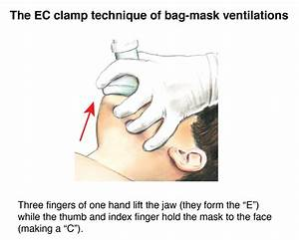
BLS FOR ADULT
Barrier devices
USE OF BAG-MASK DEVICE.
Position yourself directly above the patient’s head.
Place the mask on the victim’s face, using the bridge of the nose as a guide for correct position.
use the E-C clamp technique to hold the mask in place while you lift the jaw to hold the airway open.
perform a head-tilt.

Slide 30
BLS FOR ADULT
Barrier devices
USE OF BAG-MASK DEVICE.
Place the mask on the face with the narrow portion at the bridge of the nose.
Use the thumb and index finger of one hand to make a “ C” on the side of the mask, pressing the edges of the mask to the face.
Use the remaining fingers to lift the angles of the jaw ( 3 fingers form an “E”
open the airway, and press the face to the mask.
Squeeze the bag to give the breaths (1 second each) while watching for chest rise. (weather or not you use supplementary oxygen

Slide 31
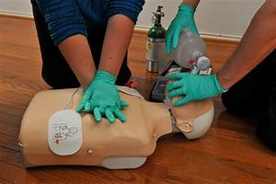
BLS FOR ADULT
ADULT 2- RESCUER SEQUENCE

Slide 32
BLS FOR ADULT
Adult 2- rescuer
The first rescuer who arrives at the side of a potential cardiac arrest victim should quickly perform the following steps.
As more rescuer arrive assign the task.
Verify that the scene is safe for the rescuer and the victim. You don’t want to become a victim yourself.
Check for responsiveness, Tap the victim’s shoulder and shout ” Are you ok”

Slide 33
BLS FOR ADULT
Adult 2- rescuer
If the victim is not responsive:
The first rescuer assess the victim and other one will activate the emergency response system and bring the AED.
If the victim is not breathing normally or is only gasping and has no pulse, immediately do the following.
One rescuer begins high-quality CPR.
Remove the clothing covering victim’s chest. (for appropriate hand and AED placement)

Slide 34
BLS FOR ADULT
Adult 2- rescuer
Once the second rescuer returns and 2 rescuers CPR provided, Rescuer should switch roles every 2 minutes or after every 5 cycles, typically when the AED is analyzing the rhythm to avoid fatigue and improve the quality of CPR.
Use The AED as soon as it is available, attach and follow the prompts.
After shock delivery or if no shock is advised, immediately resume high-quality CPR.
continues CPR until advance life support provider take over or the victim starts to breath, move or otherwise react.

Slide 35
BLS FOR ADULT
Team roles and duties
RESCUER | LOCATION | DUTIES
RESCUER 1 (Compression) | At the victim’s side | Make sure the victim is faceup on a firm, flat surface. Perform chest compression at the rate of 100-120/min. Compress the chest at least 5 CM for adult. Allow the complete chest recoil. Minimize interruptions in compressions, less than 10 s. Compression to ventilation ratio 30:2. Count compressions loudly. Switch role every 2min or 5 cycle, ( less than 5s to switch)
RESCUER 2 (Breaths) | At the victim’s head | Maintains open airway, head-tilt or jaw thrust. Give breaths, watching for chest rise, avoid excessive ventilation. Encourage the first rescuer for high-quality CPR. Switch role every 2min or 5 cycle, ( less than 5s to switch)

Slide 36
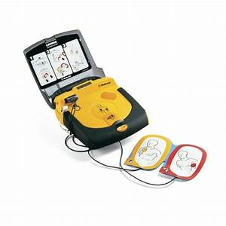
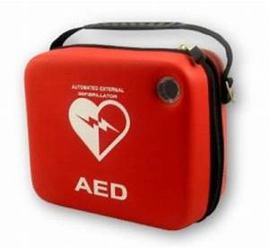
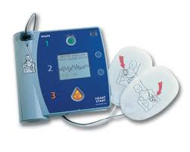
BLS FOR ADULT
Automated External defibrillator (AED)
At the end of this part, you will be able to
Describe the importance of early use of AED. (Adult and Above 8 y)
Demonstrate the appropriate use of AED.

Slide 37
BLS FOR ADULT
Automated External defibrillator (AED)
EARLY DEFIBRILLATION
The time between collapse and defibrillation is very important factor in survival from sudden cardiac arrest (V.Fib and Pulseless ventricular Tachycardia)
UNIVERSAL STEPS FOR OPERATING AED
Open the carrying case, Power on AED
Follow the prompts as a guide to next step.
Attach AED pads to victim’s bare chest. Follow the placement from diagram on packing.
Attach the AED connecting cables to the AED device.

Slide 38
BLS FOR ADULT
Automated External defibrillator (AED)
UNIVERSAL STEPS FOR OPERATING AED
“ CLEAR” the victim and allow the AED to ANALYZE the rhythm.
When the AED prompts you, clear the victim during analysis.
Be sure that no one is touching the victim, not even the rescuer in charge of giving breaths.
Some AED will tell you to push the button other will do it automatically.
AED may take few seconds to analyze.
The AED then tells you if a shock is needed.

Slide 39
BLS FOR ADULT
Automated External defibrillator (AED)
UNIVERSAL STEPS FOR OPERATING AED
If the AED advised a shock, it will tell you a clear the victim and then deliver the shock.
Clear the victim before delivering the shock, be sure that no one is touching the victim
Loudly state a “Clear the victim” message such as “EVERYBODY CLEAR” or simply “CLEAR”
Look to be sure that no one is in contact with the victim.
Press the shock button, Shock will produce a sudden contraction of the victim’s muscles.

Slide 40
BLS FOR ADULT
Automated External defibrillator (AED)
UNIVERSAL STEPS FOR OPERATING AED
If no shock is needed, and after any shock delivery ,
Immediately resume CPR, starting with chest compressions.
After 5 cycles or 2 minutes of CPR, AED will prompt you to repeat
analyze.
“DO NOT DELAY HIGH-QUALITY CPR
AFTER AED USE”

Slide 41
BLS FOR ADULT
TEAM DYNAMICS

Slide 42
BLS FOR ADULT
TEAM DYNAMICS
OVERVIEW.
Successful team dynamics are critical during a multirescuer resuscitation attempt, regardless of location.
Poor communication among team members can negatively affect performance.
Effective team dynamics may increase the chance of a successful resuscitation.
Whether you are team member or team leader its very important to understand how to communicate and perform effectively as a team member.

Slide 43
BLS FOR ADULT
TEAM DYNAMICS
Clear Roles and Responsibilities.
During a resuscitation attempt, Clear roles and responsibilities should
be defined as soon as possible.
The team leader role is to clearly define and delegate task according to
each team member’s skill level.
When all team members know their jobs and responsibilities, the team functions more effectively

Slide 44
BLS FOR ADULT
TEAM DYNAMICS
Knowing your limitations.
Each member of the team should know his/her limitations.
Team leader should also be aware of team members limitations.
Each team member should ask for assistance and advice early,
not when the situation starts to get worse.

Slide 45
BLS FOR ADULT
TEAM DYNAMICS
Constructive Intervention.
Sometimes a team member or team leader need to correct actions that are incorrect or inappropriate.
Its important to be tactful, especially if you have to correct someone who is about to make a mistake.
(whether Drug, Dose or intervention)
Any person in the team should stop someone else from making a mistake, regardless of his role in the team.

Slide 46
BLS FOR ADULT
WHAT TO COMMUNICATE?

Slide 47
BLS FOR ADULTS
TEAM DYNAMICS
Knowledge sharing.
Knowledge sharing is important for effective team performance.
Team leaders should ask frequently for observations and feedback.
This includes good ideas for management and observations
about oversights.

Slide 48
BLS FOR ADULTS
TEAM DYNAMICS
Summarizing and Re-evaluating.
Summarizing information during out loud is helpful during a resuscitation attempt for the following reasons:
Provides an ongoing record of treatment.
Acts as a way to re-evaluate the victim’s status, the interventions performed and the team’s progress with in the algorithm of care
Helps team members respond to the victim’s changing condition.

Slide 49
BLS FOR ADULT
HOW TO COMMUNICATE?

Slide 50
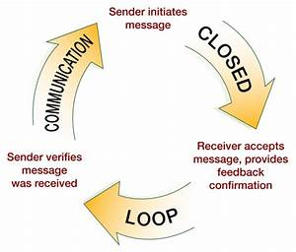
BLS FOR ADULTS
TEAM DYNAMICS
Closed-loop Communication.

Slide 51
BLS FOR ADULTS
TEAM DYNAMICS
Closed-loop Communication.
It is very important for team leader and team member.
To practice closed- loop communication, the team leader and team members should do the following:
TEAM LEADER
Call each team member by name and make an eye contact,
when giving an instructions.
Don’t assign additional task until you are sure that the team
member understand the instruction.
TEAM MEMBER
Confirm that you understand the task and acknowledge
verbally.
Tell the team leader when you have finished a task.

Slide 52
BLS FOR ADULTS
TEAM DYNAMICS
Clear Messages.
Team leader and team member should give clear messages.
Using concise and clear language helps prevent misunderstandings.
Speaking in a tone of voice that is loud enough to hear, but is also calm and confident, helps keep all team members focused

Slide 53
BLS FOR ADULTS
TEAM DYNAMICS
Mutual Respect.
All team members should display mutual respect and a professional attitude to other team members, regardless of their skill level or training.
Emotions can run high during a resuscitation attempt, so its especially important for the team leader to speak in a friendly, controlled voice and avoid shouting or aggression.

Slide 54
BLS FOR ADULTS
TEAM DYNAMICS
Debriefing.
All debriefing is an important part of every resuscitation attempt, both during and after the attempt.
Debriefing is the opportunity for the team members to identify why certain actions were taken.
Debriefing has been shown to
Help individual team members perform better.
Aid in identification of system strengths and deficiencies.
May even improve patient survival after cardiac arrest.

Slide 55
BLS FOR ADULTS

Slide 56
BLS FOR ADULTS

